Slide 1
Fermilab cable

Slide 2
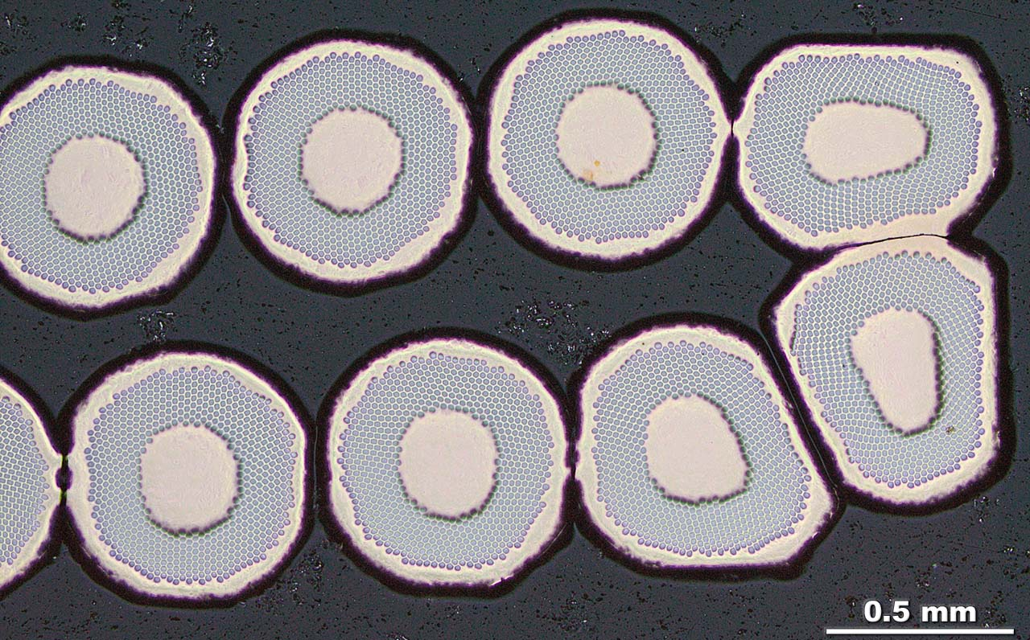

Slide 3
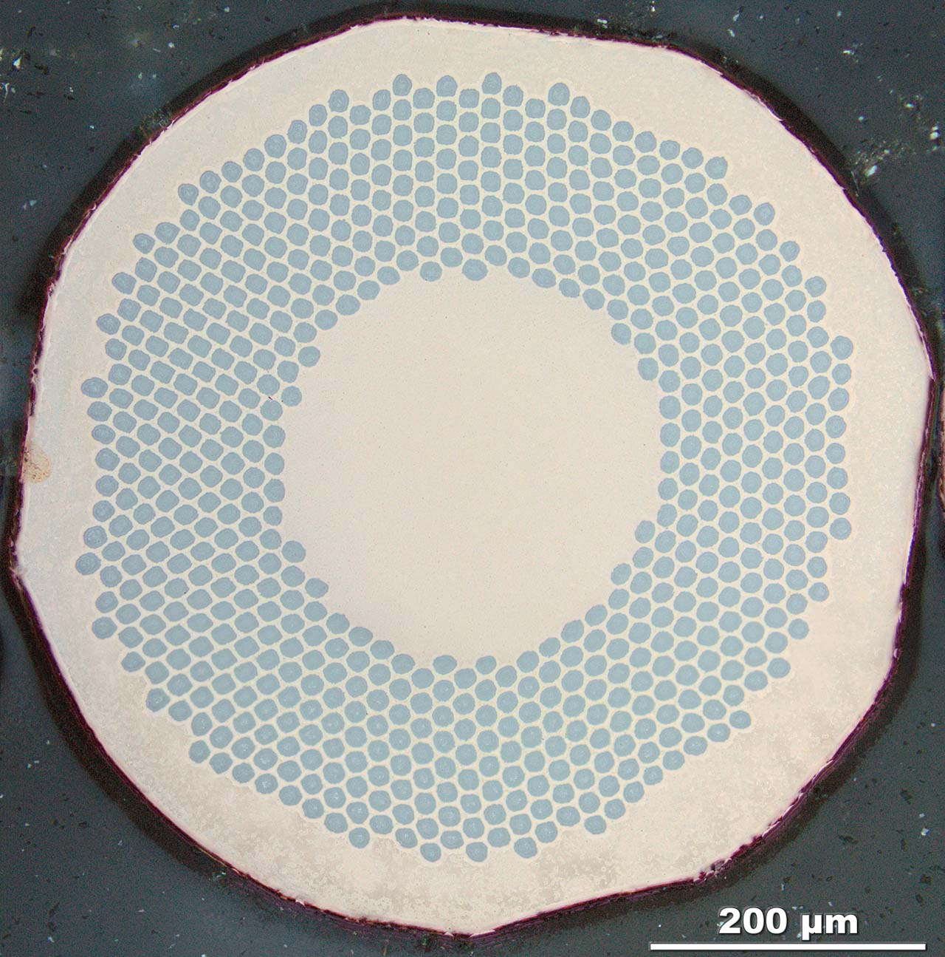

Slide 4
