Slide 1
Superconducting Strand for High Field Accelerators
Peter J. Lee and D. C. Larbalestier
The Applied Superconductivity Center
The University of Wisconsin-Madison
1st Workshop on Advanced Accelerator Magnets, Archamps, France, March 17 and 18, 2003

Slide 2
Outline
High Superconductor Options
  Alternatives to Nb₃Sn
    2212
    Nb₃Al
    MgB₂ (Recent Enhancements to H_{c2} at the UW)
Nb₃Sn
  Introduction to Fabrication Routes
  Increased Critical Current Density
    Where Does It Come From, What Are The Drawbacks
  Design Implications
  Summary of Recent Nb₃Sn Results (UW)
Conductor Issues
1st Workshop on Advanced Accelerator Magnets, Archamps, France, March 17 and 18, 2003

Slide 3
High Field Superconductors
Critical Current
Density, A/mm²
Nb-Ti: Nb-47wt%Ti, 1.8 K, Lee, Naus and Larbalestier
UW-ASC'96
10,000
At 4.2 K Unless
Nb-44wt.%Ti-15wt.%Ta: at 1.8 K, monofil. high field optimized,
unpubl. Lee, Naus and Larbalestier (UW-ASC) '96
Otherwise Stated
Nb₃Sn: Internal Sn-Rod OI-ST ASC2002
Nb
Sn
PIT
2223
3
Nb₃Sn: Internal Sn, ITER type low hysteresis loss design
Tape B||
Nb
Sn
Internal Sn
(IGC - Gregory et al.) [Non-Cu J_{c}]
3
2212
Round Wire
Nb₃Sn: Bronze route int. stab. -VAC-HP, non-(Cu+Ta) J_{c},
Thoener et al., Erice '96.
Nb₃Sn: Bronze route VAC 62000 filament, non-Cu 0.1µohm-m
1,000
Nb
Al
RQHT+2At%Cu
1.8 K J_{c}, VAC/NHMFL data courtesy M. Thoener.
3
Nb
Al
Nb₃Sn: SMI-PIT, non-Cu J_{c}, 10 µV/m, 192 filament 1 mm dia.
3
2 stage JR
(45.3% Cu), U-Twente data provided March 2000
2223
Nb
Sn Tape
Nb₃Sn: Tape (Nb,Ta)₆Sn₅+Nb-4at.%Ta core, [J_{ccore}, core ~25 %
3
of non-Cu] Tachikawa et al. '99
Tape B|_
from (Nb,Ta)
Sn
1.8 K
6
5
Nb₃Al: Nb stabilized 2-stage JR process (Hitachi,TML-NRIM,
IMR-TU), Fukuda et al. ICMC/ICEC '96
Nb
3
Al
Nb-Ti-Ta
ITER
Nb₃Al: 84 Fil. RHQT Nb/Al-Ge(1.5µm), Iijima et al. NRIM
Nb
3
Sn
ASC'98 Paper MVC-04
ITER
Nb₃Al: RQHT+2 At.% Cu, 0.4m/s (Iijima et al 2002)
100
1.8 K
Nb
Sn
Nb₃Al: JAERI strand for ITER TF coil
Nb-Ti
3
Bronze
Bi-2212: non-Ag J_{c}, 427 fil. round wire, Ag/SC=3 (Hasegawa
MT17 2000).
MgB
2
Nb
Sn
Bi 2223: Rolled 85 Fil. Tape (AmSC) B||, UW'6/96
SiC
3
PbSnMo
S
1.8 K Bronze
6
8
Bi 2223: Rolled 85 Fil. Tape (AmSC) B|_, UW'6/96
10
PbSnMo₆S₈ (Chevrel Phase): Wire in 14 turn coil, 4.2 K, 1
µVolt/cm, Cheggour et al., JAP 1997
10
15
20
25
30
MgB₂: 10%-wt SiC doped (Dou et al APL 2002, UW
Applied Field, T
measurements)

Slide 4
High Field Superconductors
Bi2212
  Highest Critical Currents above 14 T
  Flat J_{c} vs B
Nb₃Al
  High Strength
  High Critical Current Densities possible
MgB₂
  Only 2 years old, HTS is now a venerable 17 years!
  Very low cost raw materials, Ag not required.
  With improved H_{c2} provides both temperature and field margin.
1st Workshop on Advanced Accelerator Magnets, Archamps, France, March 17 and 18, 2003

Slide 5
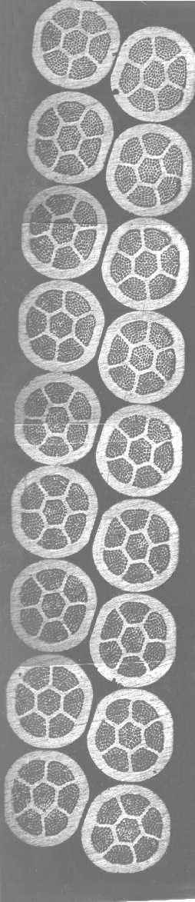
Bi-2212 round wire has been cabled for accelerator magnets.
J_{c}(12 T, 4.2 K, non-silver) > 2000 A/mm² in new material.
Long lengths( > 1500 m) are being produced.
J_{c} vs strain for Rutherford cables looks promising (LBNL results).
React/wind (BNL) and Wind/react (LBNL) coils are being made.
Cable made at LBNL
From Showa strand
Ron Scanlan (LBNL) ASC2002
1st Workshop on Advanced Accelerator Magnets, Archamps, France, March 17 and 18, 2003

Slide 6
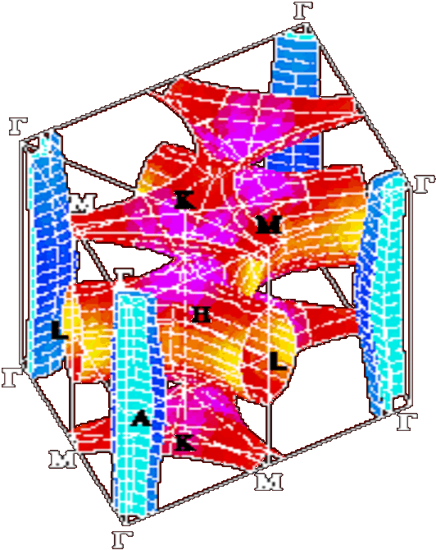
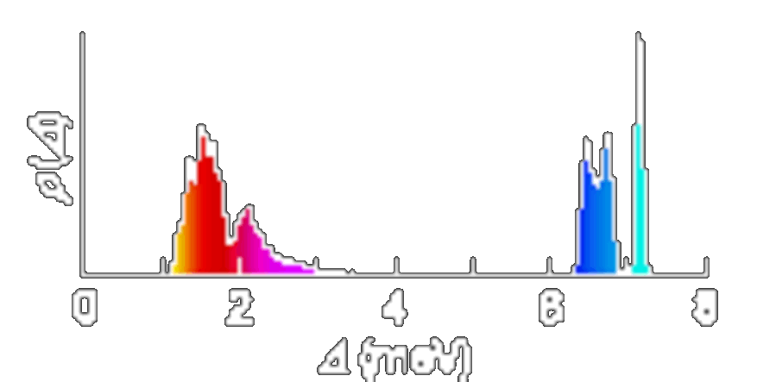
MgB₂: first 2-gap superconductor
Fermi surface from out-of-plane
π-bonding states of B p_{z} orbitals:
Δ_{π}(4.2K) ≈ 2.3 meV
small gap
Fermi surface from in-plane
σ-bonding states of B p_{xy} orbitals:
Δ_{σ}(4.2K) ≈ 7.1 meV
large gap
Choi et al.,
Nature 418 (2002) 758
V. Braccini et al. APS2003, Gurevich et al Nature
University of Wisconsin-Madison

Slide 7
MgB₂: There Are Mechanisms for increasing H_{c2}
2 gaps
3 impurity scattering channels
Intraband scattering within each σ and π sheet
Interband scattering
Increase H_{c2} by:
Increasing ρ
Selective doping of σ and π bands
by substitutions for B
by substitutions for Mg
H_{c2} is strongly enhanced as compared to the one-band WHH extrapolation H_{c2}(0) > 0.7 T_{c} H/_{c2}(T_{c})

Slide 8
Bulk: Resistivity enhancement after Mg exposure …..
1.0
0.8
1.0
(40K)
(300K)
0.6
(B) Slow cooled
B
C
A
0.5
ρ
(A) Original
ρ/ρ
/
0.4
ρ
(C) Quenched
0
0.2
35
36
37
38
39
40
0.0
T [K]
0
100
200
300
Temperature [K]
RRR: 15 3
ρ(40K): 1 μΩ cm 18 μΩ cm [B]
14 μΩ cm [C]
36.5 K [B]
37 K [C]
T_{c}: 39 K
V. Braccini et al. APL 2002 UW-ASC

Slide 9
… enhancement of H_{c2}
15
12
cm)
9
μΩ
(
6
ρ
3
0
20
5
10
15
20
25
30
35
40
T (K)
15
cm)
μΩ
10
(
ρ
5
0
5
10
15
20
25
30
35
40
T (K)

Slide 10
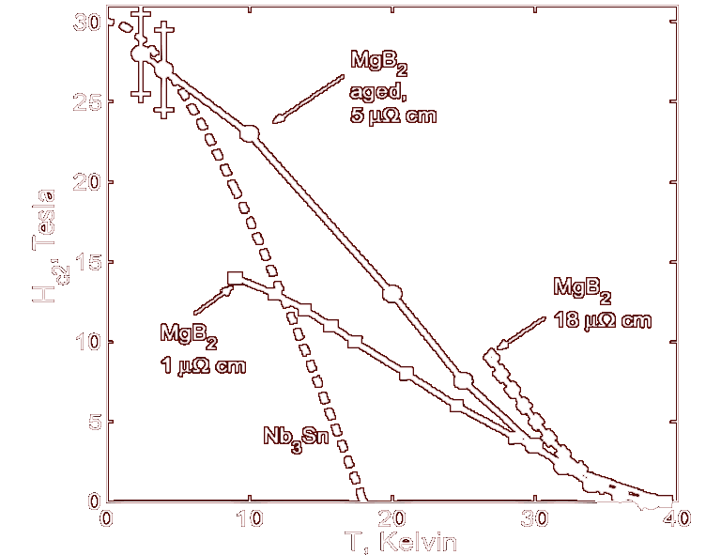
Upper critical field depends very strongly on ρ
 | T_{c},K | ρ, μΩcm | RR | dH_{c2}/dT
A | 39 | 1 | 15 | 0.5
B | 37 | 18 | 3 | 1.2
Ba | 38 | 5 | 5 | 1
B aged
Untexured bulk samples suggest that MgB₂ is capable of >30 T at 4.2 K and >10 T at 20 K.
A
B
33T resistive magnet at the NHMFL in Tallahassee, FL
V. Braccini et al. APS2003

Slide 11
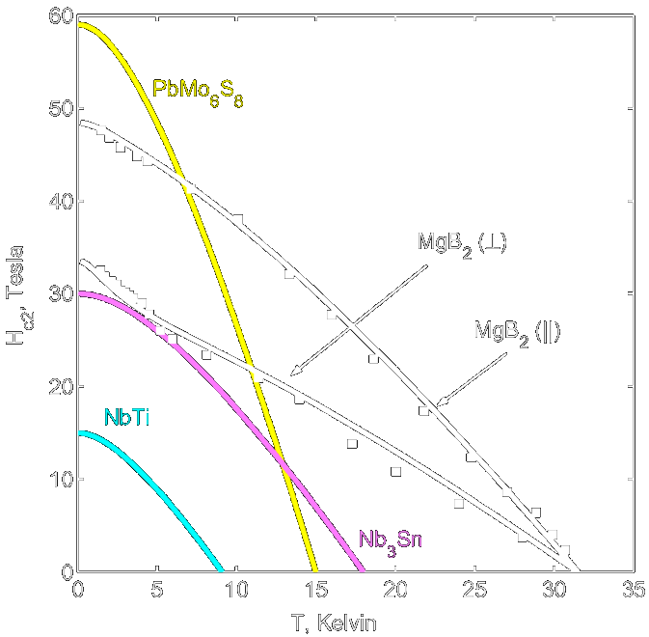
MgB₂: Enhancement Summary-Films
Gurevich et al (Nature) . . Etc. UW-Madison
Significant enhancement of H_{c2} by selective alloying
  H_{c2}⊥≈ 34 T, H_{c2}//≈ 49 T (dirty film)
  H_{c2}≈ 29 T (untextured polycrystalline bulk)
Systematic changes in ρ, T_{c}, H_{c2} in bulk and thin films
2-band physics
Thin films show that MgB₂ is capable of higher H_{c2} than even Nb₃Sn.
Wire expectation

Slide 12
So Why Nb₃Sn?
Increasing Critical Current Density at Field Range for next generation of magnets.
Production Experience
  Strand production
  Cable production
  Sub-scale dipole magnets
  ITER CS Model Coil
Multiple Vendors
Cu Stabilizer
And $$$$$$$€€€€€€€¥¥¥¥¥¥¥
1st Workshop on Advanced Accelerator Magnets, Archamps, France, March 17 and 18, 2003

Slide 13
Ron Scanlan (LBNL): ASC2002
$/kA-m improvements mostly through J_{c} improvements:
ITER
D20
KSTAR
RD-3
HD-1
Further cost improvements must come through process scale-up

Slide 14
Industrial Nb₃Sn Fabrication Processes
The bronze process continues to have a market for NMR where high n-value is important. High Cu:Sn ratios means J_{c} limited.
PIT produces d_{eff}=d_{fil} and can produce high J_{c} but is expensive and is only commercially available from one manufacturer.
Internal Sn: Both Rod and MJR can produce 2900 A/mm² 12 T, 4.2 K. Large d_{eff} in high J_{c} strands.
α
Bronze
Nb
Filaments
Diffusion
Cu
Barrier
Bronze Process
NbSn
2
+ Cu +Sn
Powder
Nb
Cu
PIT – Powder in Tube
Cu
Sn
Nb
Filaments
Diffusion
Cu
Barrier
Internal Sn (Rod Process Shown)

Slide 15
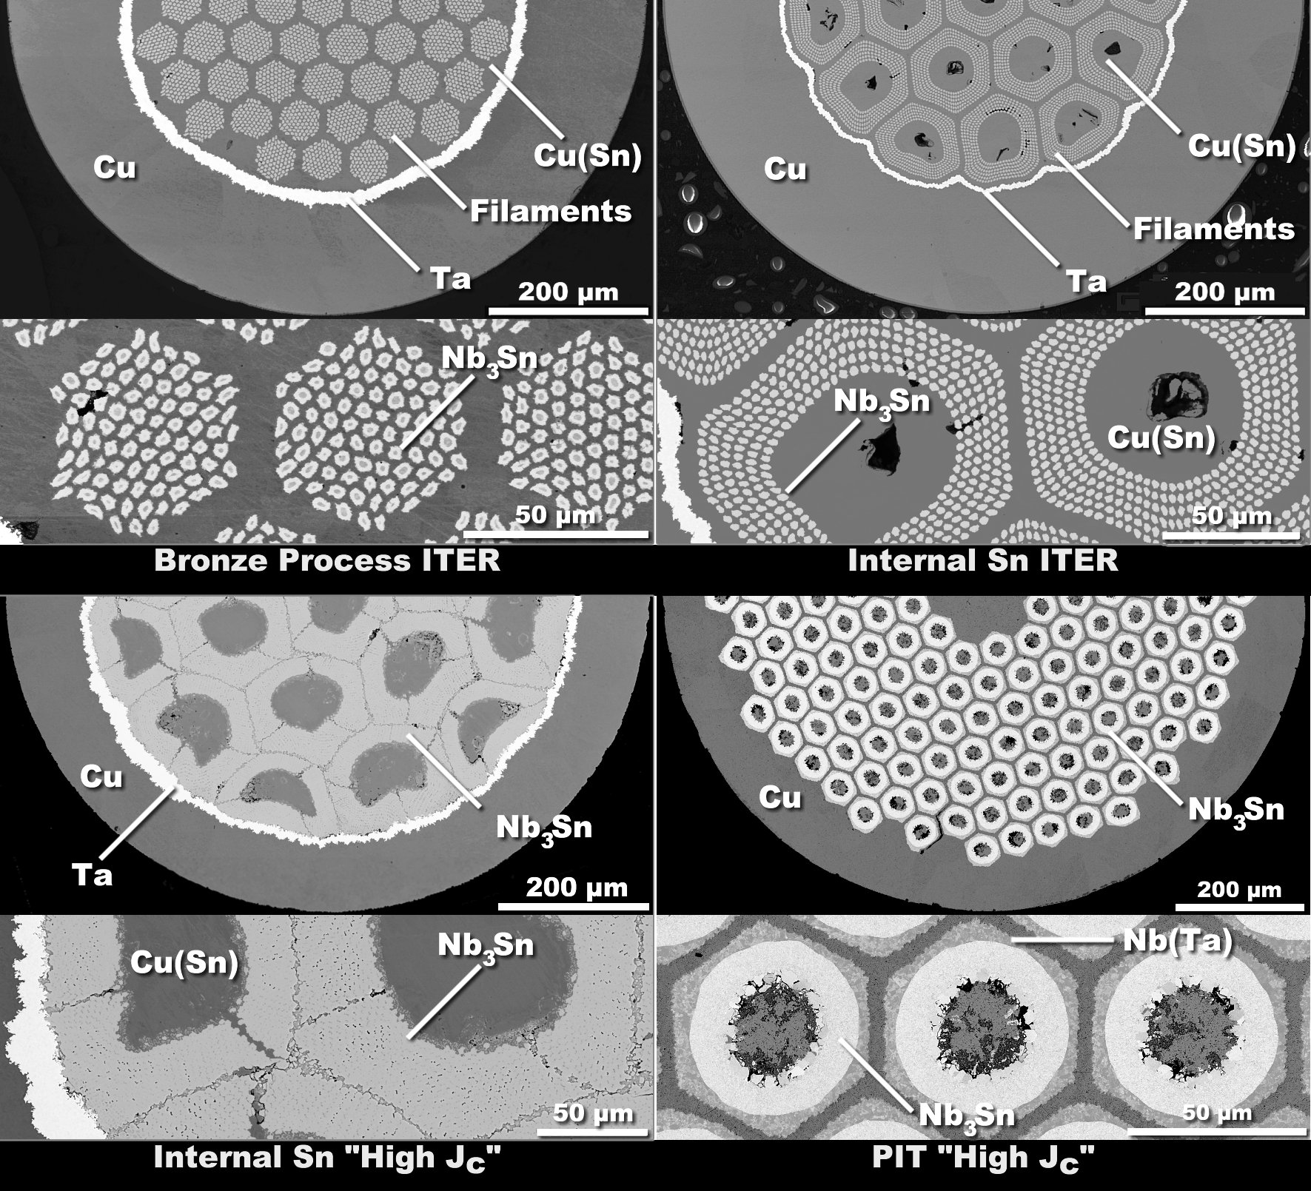
Overview of Nb₃Sn Types
ITER: Distributed Filaments. Large Cu sink for Sn. Variable and low Sn composition in A15
“High J_{c}”
Low Cu, high Sn content in A15 and high homogeneity. Large or coalesced filaments.

Slide 16
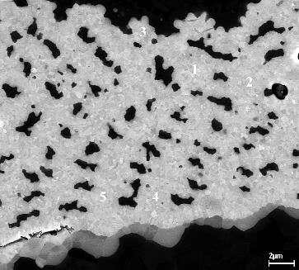
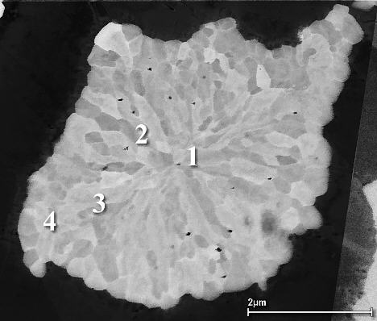
Where is the J_{c} coming from?
Layer J_{c} for low-loss ITER-style strand quite different to high J_{c} strand.
12000
High Jc Internal Sn IGC EP2-1-3-2 700°C HT
High Jc Internal Sn: ORe110(695/96)
SMI-PIT Nb-Ta Tube: 64 hrs@675 °C-small grains
10000
High Jc Internal Sn MJR TWC1912
504 Filament SMI-PIT, small grains only
ITER: Mitsubishi Internal Sn
8000
ITER: LMI Internal Sn
ITER: Furukawa Bronze Process
ITER: VAC 7.5% Ta Bronze Process
Layer Critical Current Density, A/mm²
23-24.5 At.% Sn in A15, equiaxed grains uniform across layer
6000
“high J_{c}”
4000
2000
ITER low loss
Nb₃Sn
0
7
8
9
10
11
12
13
14
15
16
Applied Field, T
22-24 At.% Sn in A15, equiaxed to columnar transition
“High J_{c}” strand has much less Cu (more hysteresis loss) and more Sn and Nb. High Sn levels maintained throughout reaction

Slide 17
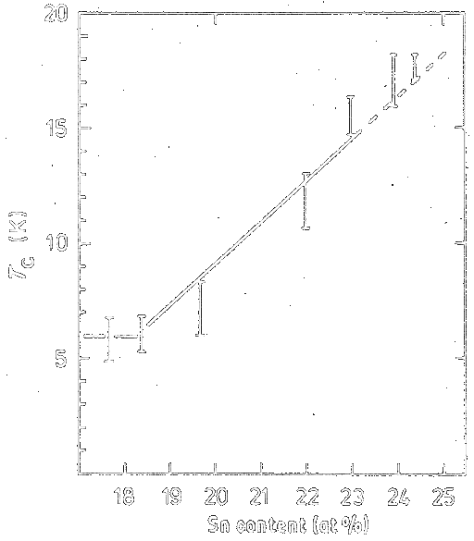
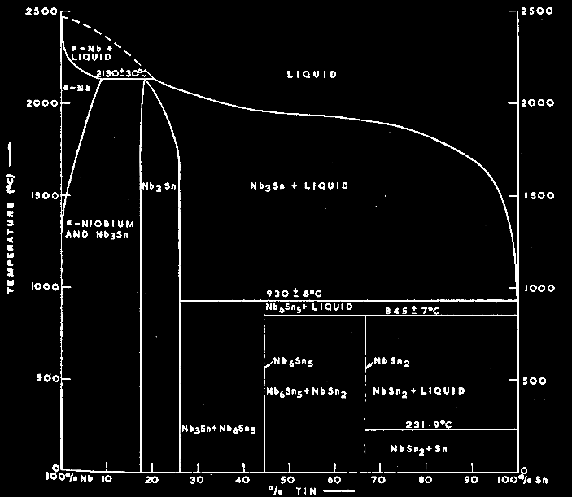
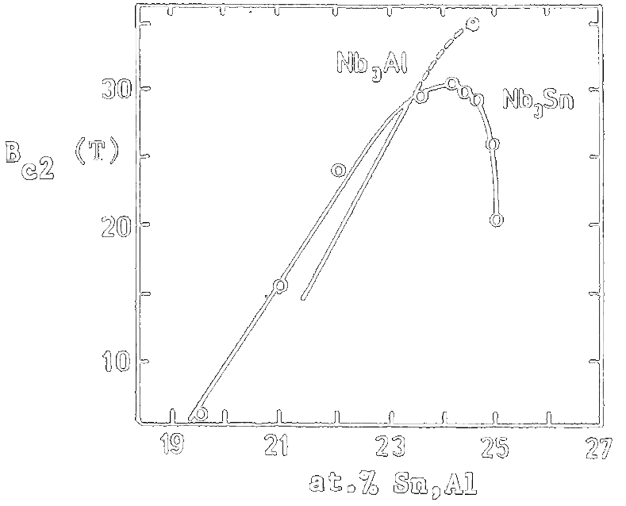
Composition, T_{c} and H_{c2} effects in Nb₃Sn
Devantay et al. J. Mat. Sci., 16, 2145 (1981)
Charlesworth et al. J. Mat. Sci., 5, 580 (1970)
Sn, T_{c} and H_{c2} gradients!
Nb₃Sn is seldom Nb-25at%Sn
Data compiled by Devred from original data assembled by Flukiger, Adv. Cryo. Eng., 32, 925 (1985)

Slide 18
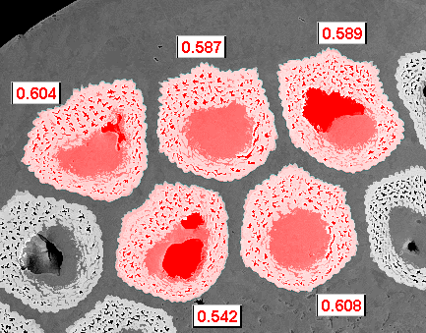
“High J_{c}” in Internal Sn is achieved by reducing the Cu between the filaments to a minimum while maintaining Sn levels
MJR can reach ~10:1 Nb:Cu in Filament pack. RIT ~ 4:1
2700
2600
2500
2400
J_{c}(A/mm²)
2300
2200
2100
Calc.
2000
Meas.
1900
30
35
40
45
50
55
At % Nb
Outokumpu Advanced Superconductors (OAS) DOE-HEP CDP program reported by Ron Scanlan at ASC2002
A15 % in OI-ST MJR Sub-elements at 60% in the 2200 A/mm² strand
Note the 10% variation through Sn redistribution during HT

Slide 19
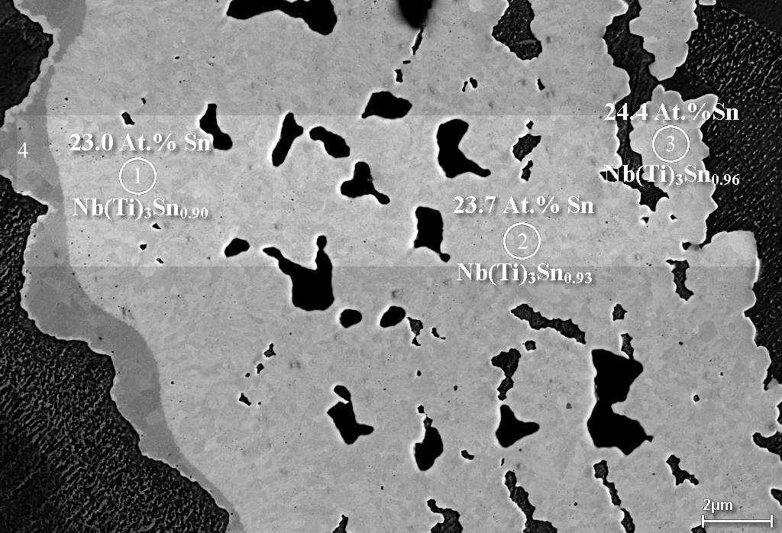
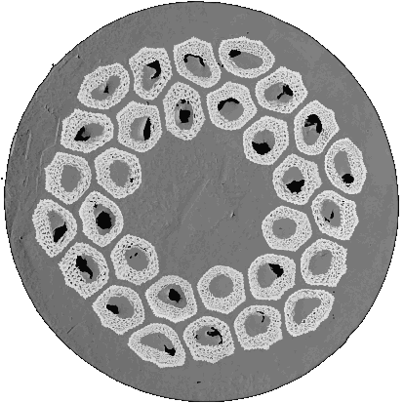
“High J_{c}” A15 – Thick layers, shallow composition gradient, high Sn, low Cu (2200 A/mm², 12 T, 4.2 K)
A15
Void
Cu(Sn)
Nb barrier
Sn Diffusion
Cu
Nb₃Sn
Cu

Slide 20
Columnar are markers for local Sn deficiency
Columnar A15 growth is observed when Sn supply is diminished
Increased aspect ratio can be used to indicate reduced Sn in the A15
Using this method the local A15 inhomogeneity can be implied on a sub-micron scale.
2
OI-ST MJR From Cu Islands
OI-ST MJR From Voids
1.9
IGC-RIT from Cu Islands
IGC-RIT from Voids
1.8
Aspect Ratio
1.7
2.4
1.6
2.2
2
Aspect Ratio
1.8
1.6
1.5
1.4
0
500
1000
1500
2000
Distance from Center of Original Nb (Rod) Filament, nm
1.4
0
200
400
600
800
1000
P. J. Lee, C. M. Fischer, M. T. Naus, A. A. Squitieri, D. C. Larbalestier, "The Microstructure and Microchemistry of High Critical Current Nb3Sn Strands Manufactured by the Bronze, Internal-Sn and PIT Techniques," Applied Superconductivity Conference , 2002. http://128.104.186.21/asc/pdf_papers/760.pdf
Distance from feature, nm

Slide 21
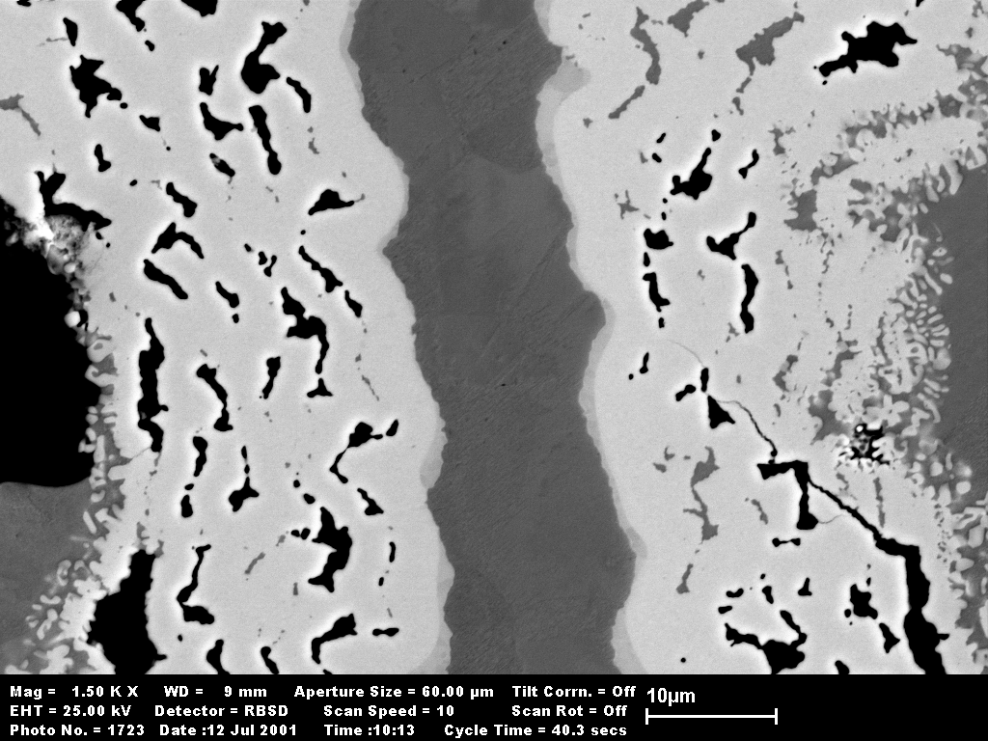
In low-Cu “high J_{c}” strand – Nb dissolution
Nb dissolution causes loss in contiguous A15 area.
When the Nb barrier is fully reacted, Sn diffuses in the stabilizer Cu - enabling LBNL SC group to control RRR by HT

Slide 22
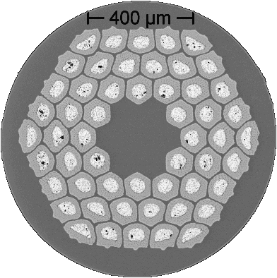
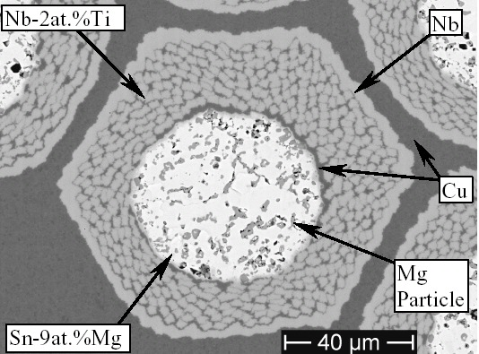
OI-ST MJR Very High J_{c}: 2900 A/mm², 12 T
MJR (ORe137): <15 volume % Cu in sub-element
Significant excess Sn even including barrier
The Sn core is larger than required to react all Nb and Nb(Ti) and form stoichiometric Nb₃Sn
Mike Naus (LTSW ’01) and PhD thesis 2002 shows important role of Sn:Nb in determining T_{c} and Hc2: http://128.104.186.21/asc/pdf_papers/theses/mtn02phd.pdf

Slide 23
Mike Naus: Universal Plot of Goodness
30
30
CRe1912, 4h650°C
CRe1912, 4h650°C
CRe1912, 4h650°C
CRe1912, 180h650°C
Mike Naus: LTSW 2001
CRe1912, 180h650°C
CRe1912, 180h650°C
CRe1912, 4h750°C
CRe1912, 4h750°C
CRe1912, 4h750°C
CRe1912, 256h750°C
CRe1912, 256h750°C
24
CRe1912, 256h750°C
24
ORe102, 4h650°C
ORe102, 4h650°C
4.2 K
ORe102, 4h650°C
ORe102, 180h650°C
ORe102, 180h650°C
(T)
ORe102, 180h650°C
(T)
ORe102, 4h750°C
ORe102, 4h750°C
ORe102, 4h750°C
ORe102, 256h750°C
ORe102, 256h750°C
18
ORe102, 256h750°C
18
ORe110, 0.7 mm, 96h/695°C
ORe110, 0.7 mm, 96h/695°C
Kramer
ORe110, 0.7 mm, 96h/695°C
ORe110, 1.0 mm, 96h/695°C
ORe110, 1.0 mm, 96h/695°C
ORe110, 1.0 mm, 96h/695°C
H*
H*
ORe137, 180h675°C
ORe137, 180h675°C
ORe137, 180h675°C
ORe139, 180h675°C
ORe139, 180h675°C
ORe139, 180h675°C
12
PIT, ternary, 4h/675°C
12
PIT, ternary, 4h/675°C
PIT, ternary, 4h/675°C
PIT, ternary, 8h/675°C
PIT, ternary, 8h/675°C
PIT, ternary, 8h/675°C
PIT, ternary, 64h/675°C
PIT, ternary, 64h/675°C
12 K
PIT, ternary, 64h/675°C
PIT,ternary, 64h/800°C
PIT,ternary, 64h/800°C
PIT,ternary, 64h/800°C
PIT, ternary, 8h/850°C
PIT, ternary, 8h/850°C
6
PIT, ternary, 8h/850°C
6
14
14
15
15
16
16
17
17
18
18
T
T
(K)
(K)
c,50%
c,50%
Remarkably this plot includes non-alloyed, Ta and Ti alloyed Nb₃Sn
http://128.104.186.21/asc/pdf_papers/theses/mtn02phd.pdf

Slide 24
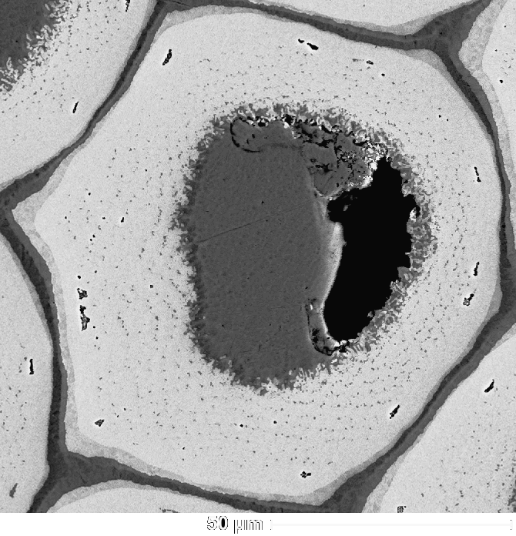
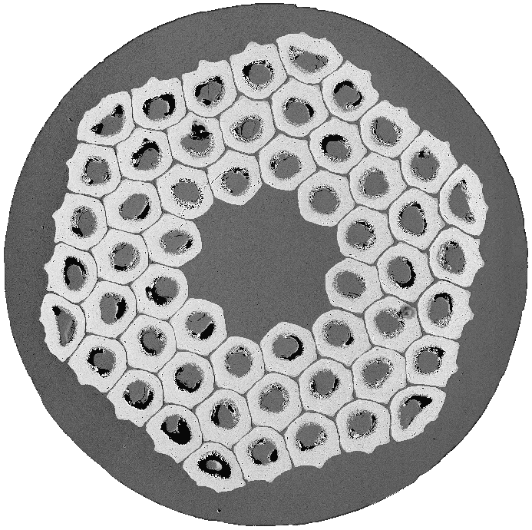
2900 A/mm² in OI-ST: also in RRP*
Nb-Ta alloy rod stack
More Cu remains between filaments than in MJR
Sub-elements very close together
Barrier breached and external A15 formed
  RRR control feature?!
Some dissolution of Nb into core.
*1000m lengths available.
  *(this note added in postcript
    thanks to Ron Scanlan – LBNL).
*RRP=Rod Restack
Process

Slide 25
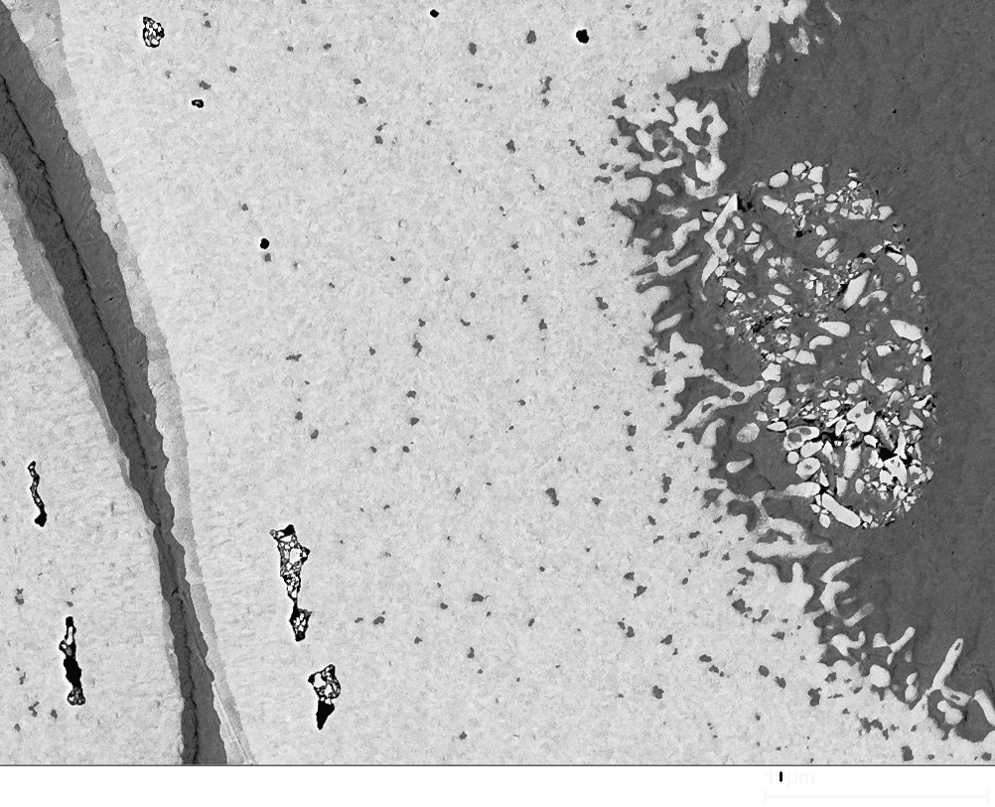
2900 A/mm² in OI-ST RRP
FESEM-BEI image showing barrier, sub-element spacing and Nb dissolution
Cu(Sn) Core
Nb barrier
Stabilizer Cu
Cu(Sn)
Void
A15

Slide 26
Sub-element uniformity: very good
Sub-element cross-sectional areas:
  Coefficient of variation 2.7% - equivalent to good SSC Nb-Ti strand
    Compares to 1.1-2.2 % for SMI-PIT B34 Filaments
    0.8 % for Edge Strengthened B134 Filament
But sub-elements are still too-large (~100µm) and the barriers too thin.
1st Workshop on Advanced Accelerator Magnets, Archamps, France, March 17 and 18, 2003

Slide 27
Microchemistry: Center of A15 layer
RRP 6445 2900 A/mm² HT and J_{c} by OI-ST (Kramer extrapolation)
  Nb(Ta): 25.0 Atomic % Sn (Ignoring 1.4 At.% Cu signal)
  2900 A/mm² + Confirmed in transport by OI-ST in RRP6555-A, 0.8mm
SMI-PIT B134 80hrs at 675 °C, J_{c} (non-Cu) 1961 A/mm² 12 T
  24.0 Atomic % Sn (Ignoring 1.2 At. % Cu Signal)
SMI-PIT B34 64hrs at 675 °C, J_{c} (non-Cu) 2250 A/mm² 12 T
  24.1 Atomic % Sn (Ignoring 2.0 At. % Cu Signal)
Conditions: FESEM EDS Analysis
Same session, fresh calibration, 20 kV
1 sigma Sn error <0.22 Atomic %
PIT J_{c} data: All measured by transport by UW

Slide 28
OI-ST 2900 A/mm² Strand: New J_{csc}
12000
OI-ST 6445 RRP 0.9 mm (Parrell et al. ASC2002)
OI-ST RRP 0.9 mm Kramer Extrapolation
Non-Cu:A15 ratio from image analysis of high resolution FESEM images of 4 sub-elements
High J_{c} Internal Sn IGC EP2-1-3-2 700°C HT
High J_{c} Internal Sn: ORe110(695/96)
10000
SMI-PIT Nb-Ta Tube: 64 hrs@675 °C-small grains
High J_{c} Internal Sn MJR TWC1912
504 Filament SMI-PIT, small grains only
ITER: Mitsubishi Internal Sn
8000
ITER: LMI Internal Sn
ITER: Furukawa Bronze Process
ITER: VAC 7.5% Ta Bronze Process
Layer Critical Current Density, A/mm²
6000
4000
OI-ST RRP
2900 A/mm²
(12T, 4.2K)
2000
0
7
8
9
10
11
12
13
14
15
16
Applied Field, T
1st Workshop on Advanced Accelerator Magnets, Archamps, France, March 17 and 18, 2003

Slide 29

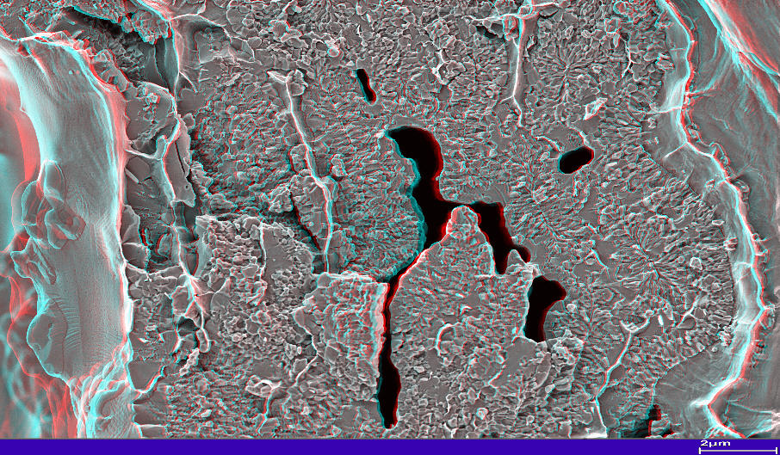
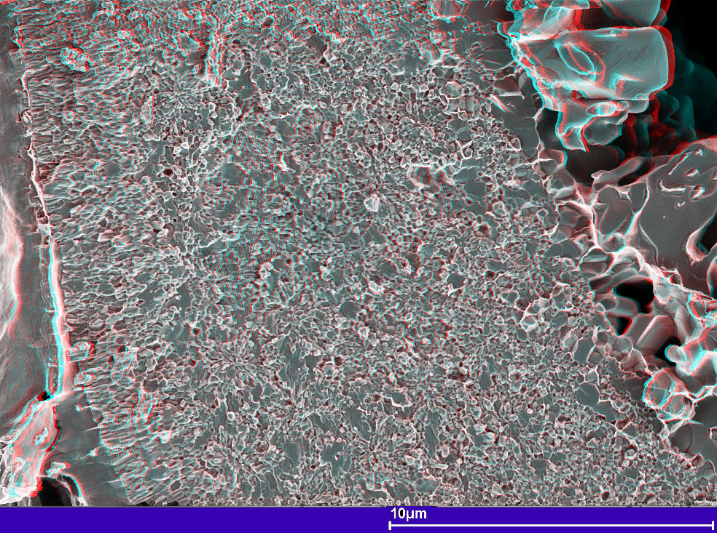
Ta alloy rod produces larger grains
ORe110
Ti alloy MJR
OI-ST
Ta alloy RRP

Slide 30
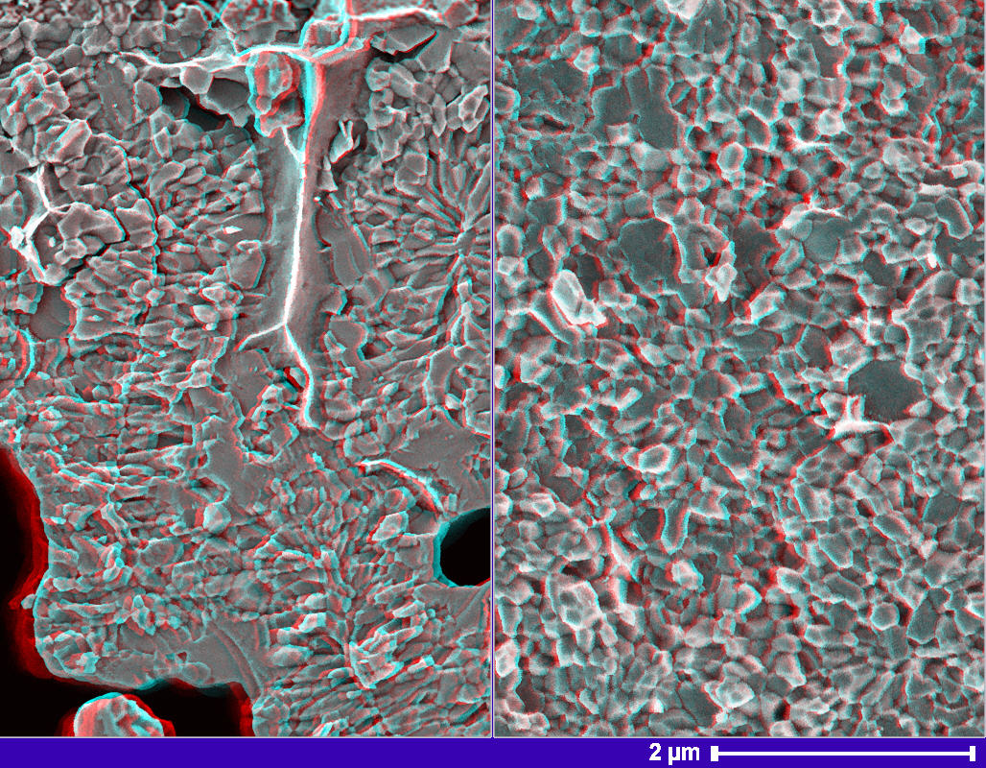

Ta alloy rod produces larger grains
ORe110
Ti alloy MJR
OI-ST
Ta alloy RRP
(d*~140 nm)
(d*~180 nm)

Slide 31
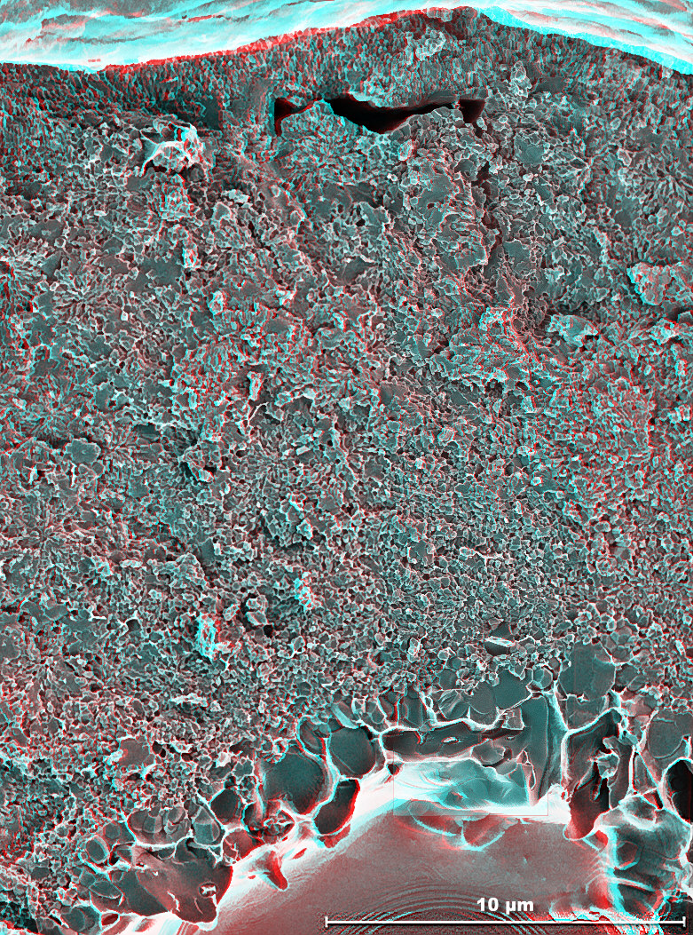
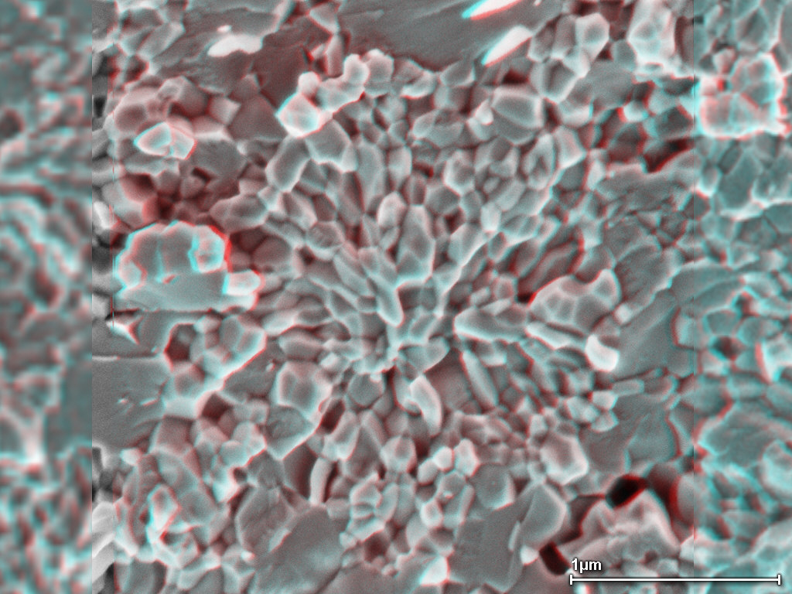
A layer of large A15 grains surrounds the core – starting to look like PIT
RRP: Outer row, outer layer
Some morphology associated with original rods

Slide 32
Thus the Q_{gb} must be higher . . .
We calculate the specific boundary pinning force, Q_{GB}, using Kramer’s formalism:
Q_{GB}=F_{p}/λS_{gb}
where λ is an efficiency factor which accounts for the proportion of the grain boundary that is oriented for pinning. We apply a value of 0.5 for λ, a value previously used for columnar grains
OI-ST 6445 RRP 0.9 mm (Parrell et al. ASC2002)
16000
OI-ST RRP 0.9 mm Kramer Extrapolation
High J_{c} Internal Sn IGC EP2-1-3-2 700°C HT
High J_{c} Internal Sn: ORe110(695/96)
SMI-PIT Nb-Ta Tube: 64 hrs@675 °C-small grains
14000
ITER: High J_{c} Internal Sn TWC1912 Q_{gb}
504 Filament SMI-PIT, excluding large grains
ITER: Mitsubishi Internal Sn Q_{gb}
12000
ITER: LMI Internal Sn Qgb
ITER: Furukawa Bronze Process Q_{gb}
ITER: VAC 7.5% Ta Bronze Process Q_{gb}
10000
Q_{gb} in N/m²
8000
OI-ST RRP
2900 A/mm²
(12T, 4.2K)
6000
4000
2000
Grain Boundary Density from IA of ONE fracture image!
0
7
8
9
10
11
12
13
14
15
16
Applied Field, T

Slide 33
F_{p} Very High for “High J_{c}” Nb₃Sn
Nb-Ti: APC strand Nb-47wt.%Ti with
100
24vol.%Nb pins (24nm nominal diam.) -
Nb
Sn
Heussner et al. (UW-ASC)
3
Nb
Sn Internal Sn
Nb-Ti: Best Heat Treated UW Mono-
Cu plated APC
Nb
Sn
3
Filament. (Li and Larbalestier, '87)
"High
3
J
"
ITER
c
2212 Tape
Nb-Ti: Nb-Ti/Nb (21/6) 390 nm multilayer
'95 (5°), 50 µV/cm, McCambridge et al.
(Yale)
Nb₃Sn: Sn plated Cu APC, 40 hr@650
Nb-Ti
°C, R. Zhou PhD Thesis (OST), '94
(GN/m³)
MultiLayer
Nb₃Sn: Mitsubishi ITER BM3 Internal
NbN
Sn
p
F
Nb₃Sn Strand: High J_{c} Internal Sn RRP
2223
Nb
Al RIT
(Parrell et al ASC'02)
10
3
Tape B||
Nb₃Al: Transformed rod-in-tube Nb₃Al
Bulk Pinning Force,
(Hitachi,TML-NRIM), Nb Stabilized - non-
HT Nb-Ti
Nb J_{c}, APL, vol. 71(1), pp.122-124), 1997
NbN: 13 nmNbN/2 nmAlN multi-layer || B,
Gray et al. (ANL) Physica C, 152 '88
YBCO: /Ni/YSZ ~1 µm thick
microbridge, H||ab 75 K, Foltyn et al.
APC Nb-Ti
(LANL) '96
Bi-2212: 19 filament tape B||tape face -
MgB
Okada et al (Hitachi) '95
SiC
2
Bi 2223: Rolled 85 Fil. Tape (AmSC) B||,
UW'6/96
1
MgB₂: 10%-wt SiC doped (Dou et al
0
5
10
15
20
25
APL 2002, UW measurements)
Applied Field (T)

Slide 34
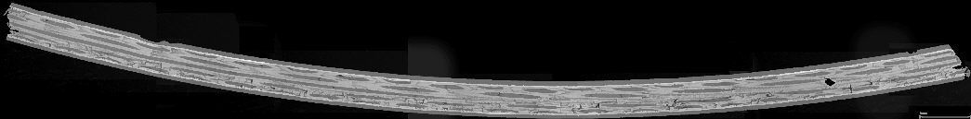
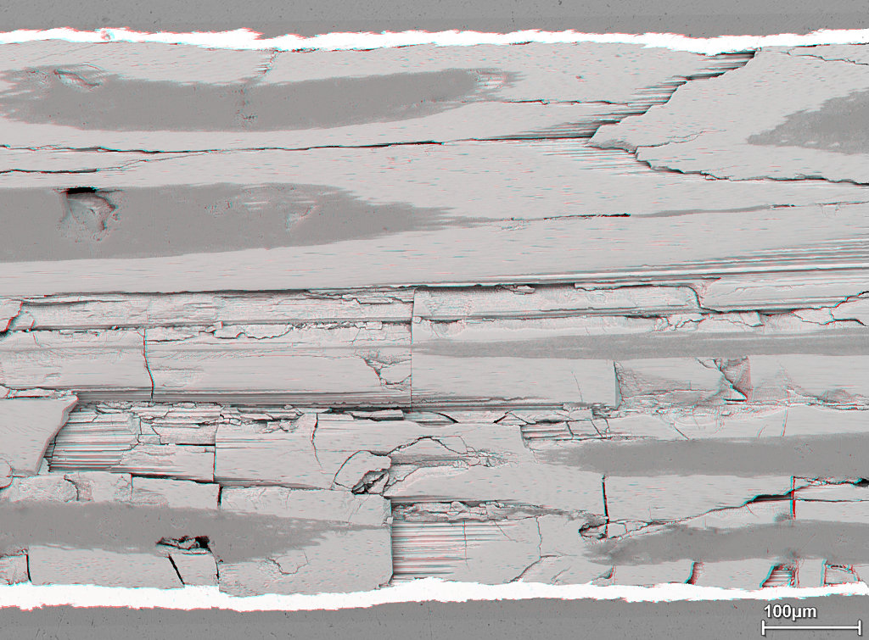
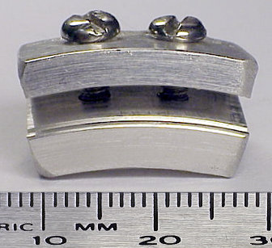
High J_{c} Internal Sn (twisted): 0.5% Bend Strain
Nb₃Sn is susceptible to filament breakage under small bend strains ~0.5%
If the Nb₃Sn layer us continuous (as in the prototype IGC-AS strand) breakage spans the entire tensile side.
Compressive
Nb₃Sn
Tensile
Cu
Barrier

Slide 35

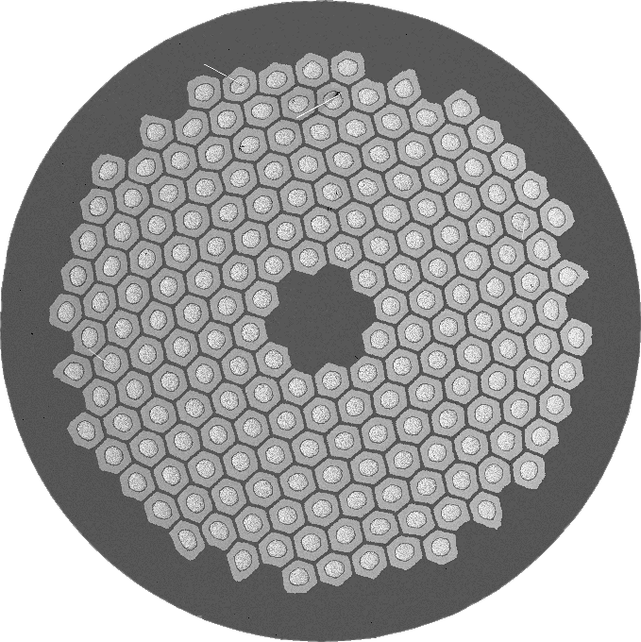
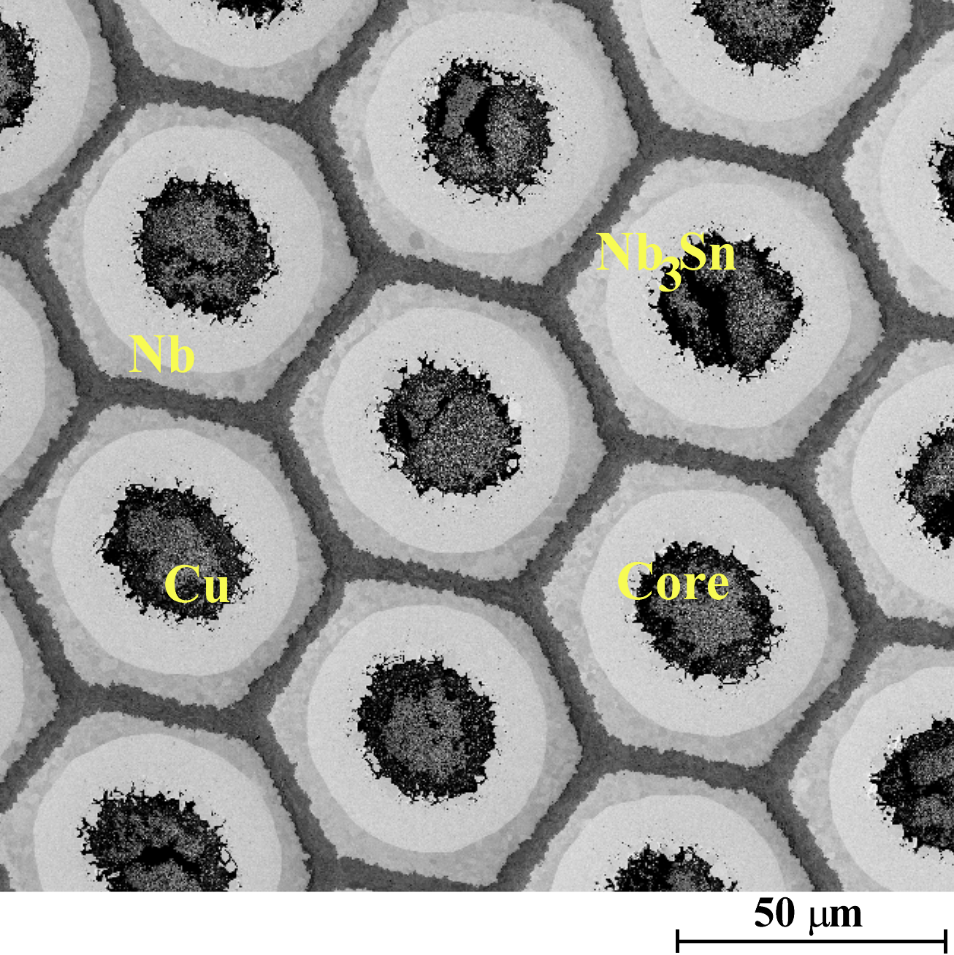
PIT geometry leaves thick unreacted Nb and corners of hexagonal filaments.
Commercial PIT strand is manufactured by Shapemetal Innovation BV, the Netherlands. This process was originally developed by ECN and is termed the ECN process.
SMI-PIT filaments are otherwise remarkably homogeneous in area cross-section
Nb or Nb-Ta tube
Sn-rich powders
Cu
Before HT: Homogeneous stack of powder in Nb tubes
After HT: Weakly bonded porous core left inside A15

Slide 36
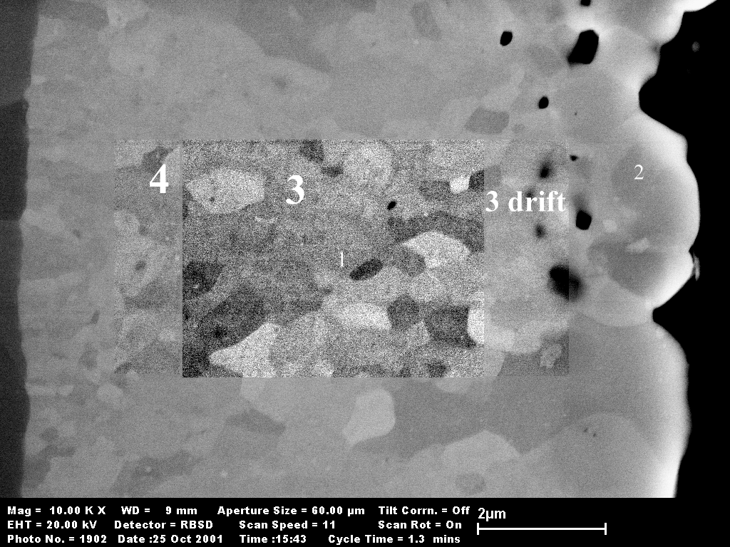
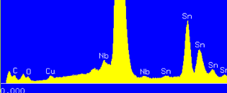
Very high Sn levels can be achieved at elevated temperatures: PIT(Ta): SMI 34 64hrs@800C
25.20 (±0.1) At.%Sn*
Nb(Ta)
A15
Core
24.8 (±0.2) At.%Sn*
24.5 (±0.3) At.%Sn*
* = ignoring Cu
Very large grain sizes, however, result in low J_{c}

Slide 37
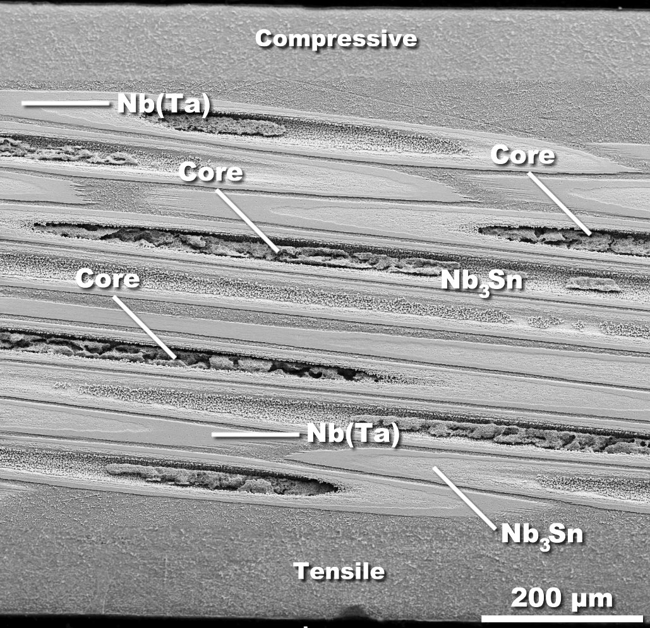
Powder-in-tube Nb(Ta): Twisted, 0.5% bend
No cracking seen at 0.5% strain (eventually cracks at 0.6%)
Although the Nb layer reduces the efficiency of the non-Cu package it applies more precompression to the A15
300
I
c
[A
]
Godeke et al. (Twente) IEEE Trans. Appl. SC, 9(2), 1999.
250
10
T
,
4.
2 K
200
10
T
,
6.
5 K
13
T
,
4.
2 K
13
T
,
6.
5 K
150
100
Matthew C. Jewell, Peter J. Lee and David C. Larbalestier, "The Influence of Nb₃Sn Strand Geometry on Filament Breakage under Bend Strain as Revealed by Metallography", Submitted at the 2nd Workshop on Mechano-Electromagnetic Property of Composite Super-conductors, for publication in Superconductor Science and Technology (SuST), March 3rd 2003. http://www.cae.wisc.edu/%7Eplee/pubs/pjl-mcj-mem03-sust.pdf
50
0
ε
a
[%
]
-
0
.
4
-
0
.
2
0.
0
0
.
2
0.
4
0
.
6
0.
8

Slide 38
Summary: Recent UW Nb₃Sn Results
Remarkable improvements in the critical current densities (layer and non-Cu) of Nb₃Sn have been observed in Nb₃Sn strand fabricated by the PIT and Internal Sn process.
Grain Size of this Ta-alloyed conductor is small enough to yield high J_{c} but is larger (d*~180 nm) than found in Nb(Ti) MJR (d*~140 nm).
  Remarkably high Q_{gb} suggests that the grain boundary chemistry is different.
If Nb(Ta)₃Sn grain size can be reduced without sacrificing stoichiometry further advances should be possible.
Effective filament diameter is 30 (PIT) -100 µm (Internal Sn) and needs to be improved.
PIT bend results suggest better strain tolerance could be achieved
Lee: 1st Workshop on Advanced Accelerator Magnets, Archamps, France, March 17 and 18, 2003

Slide 39
Accelerator Conductor Issues
Can the effective filament size for “High J_{c}” Nb₃Sn strand be reduced.
Can the cost of PIT strand be reduced?
Can the cost of all the other Nb₃Sn strands be reduced?
Are we close to the limit for Nb₃Sn strand J_{c}?
Can we engineer enough “Stress Relief” for Nb₃Sn
Can Nb₃Al be made in long lengths at low cost?
Will MgB₂ continue to make gains, should it be supported?
  Can the high T_{c} be exploited?
Lee: 1st Workshop on Advanced Accelerator Magnets, Archamps, France, March 17 and 18, 2003

Slide 40
Bibliography
M. T. Naus, "Optimization of Internal-Sn Nb₃Sn Composites," Ph.D. Thesis, Materials Science Program, University of Wisconsin-Madison, 2002. http://128.104.186.21/asc/pdf_papers/theses/mtn02phd.pdf
P. J. Lee, C. M. Fischer, M. T. Naus, A. A. Squitieri, D. C. Larbalestier, "The Microstructure and Microchemistry of High Critical Current Nb₃Sn Strands Manufactured by the Bronze, Internal-Sn and PIT Techniques," Applied Superconductivity Conference , 2002. http://128.104.186.21/asc/pdf_papers/760.pdf
M. T. Naus, M. C. Jewell, P. J. Lee, D. C. Larbalestier, "Lack of Influence of the Cu-Sn Mixing Heat Treatments on the Super-Conducting Properties of Two High-Nb, Internal-Sn Nb₃Sn Conductors," CEC-ICMC Advances in Cryogenic Engineering, 48[B], 1016-1022, 2002. http://128.104.186.21/asc/pdf_papers/698.pdf
C. M. Fischer, "Investigation of the Relationships Between Superconducting Properties and Nb₃Sn Reaction Conditions in Powder-in-Tube Nb₃Sn Conductors," M.S. Thesis, Materials Science Program, University of Wisconsin-Madison, 2002. http://128.104.186.21/asc/pdf_papers/theses/cmf02msc.pdf
C. M. Fischer, P. J. Lee, D. C. Larbalestier, "Irreversibility Field and Critical Current Density as a Function of Heat Treatment Time and Temperature for a Pure Niobium Powder-in-Tube Nb3Sn Conductor," CEC-ICMC Advances in Cryogenic Engineering, 48[B], 1008-1015, 2002. http://128.104.186.21/asc/pdf_papers/704.pdf
P. J. Lee, C. D. Hawes, M. T. Naus, A. A. Squitieri, D. C. Larbalestier, Compositional and Microstructural Profiles across Nb₃Sn Filaments", IEEE Transactions on Applied Superconductivity, 11(1), pp. 3671-3674, 2001. http://128.104.186.21/asc/pdf_papers/662.pdf
Matthew C. Jewell, Peter J. Lee and David C. Larbalestier, "The Influence of Nb₃Sn Strand Geometry on Filament Breakage under Bend Strain as Revealed by Metallography", Submitted at the 2nd Workshop on Mechano-Electromagnetic Property of Composite Super-conductors, for publication in Superconductor Science and Technology (SuST), March 3rd 2003. http://www.cae.wisc.edu/%7Eplee/pubs/pjl-mcj-mem03-sust.pdf
R. M. Scanlan, “Conductor development for high energy physics-plans and status of the US program,”, IEEE Transactions on Applied Superconductivity, 11(1) , pp: 2150 –2155, Mar 2001. http://ieeexplore.ieee.org/iel5/77/19887/00920283.pdf?isNumber=19887&prod=IEEE+JNL&arnumber=920283&arSt=2150&ared=2155&arAuthor=Scanlan%2C+R.M.%3B
R. M. Scanlan, D. R. Dietderich, Progress and Plans for the U. S. HEP Conductor Development Program, ASC2002 presentation 5LA04.
V. Braccini, L. D. Cooley, S. Patnaik, P. Manfrinetti, A. Palenzona, A. S. Siri, D. C. Larbalestier, "Significant Enhancement of Irreversibility Field in Clean-Limit Bulk MgB₂," APL, 9 Dec. 2002; 81(24): 4577-9. http://arxiv.org/ftp/cond-mat/papers/0208/0208054.pdf
J.A. Parrell, Y. Zhang, M.B. Field, P. Cisek, S. Hong, High Field Nb₃Sn Conductor Development at Oxford Superconducting Technology,” ASC 2002 Paper 5MJ01. Accepted for publication in IEEE Trans. Applied Superconductivity.

Slide 41
Acknowledgments
Ron Scanlan (LBNL): Who leads the US-DOE HEP Conductor Development Program supplied additional slides.
Jeff Parrell, Mike Field and Seung Hong at OI-ST have advanced the properties of Nb₃Sn at a remarkable rate and have provided strand samples to both Labs and Universities.
Tae Pyon and Eric Gregory (now with Accelerator Technology Corp) of IGC-AS (now Outokumpu Advanced Superconductors) supplied additional internal Sn strands for these studies.
Jan Lindenhovius of Shapemetal Innovation BV, supplied the UW with PIT strand for these studies.
Mike Naus and Chad Fischer (now with Intel) provided much of the internal Sn and PIT (respectively) data presented here as graduate students at the University of Wisconsin-Madison

