Slide 1
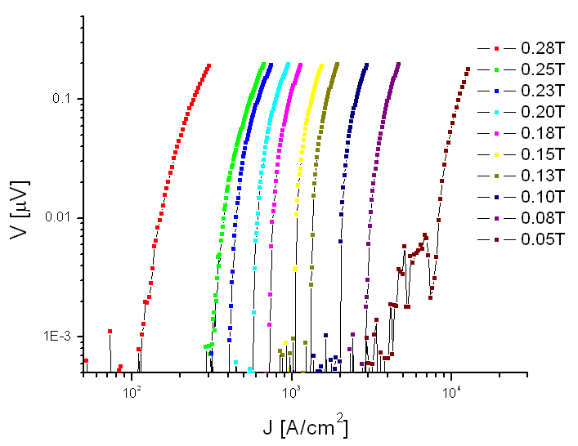
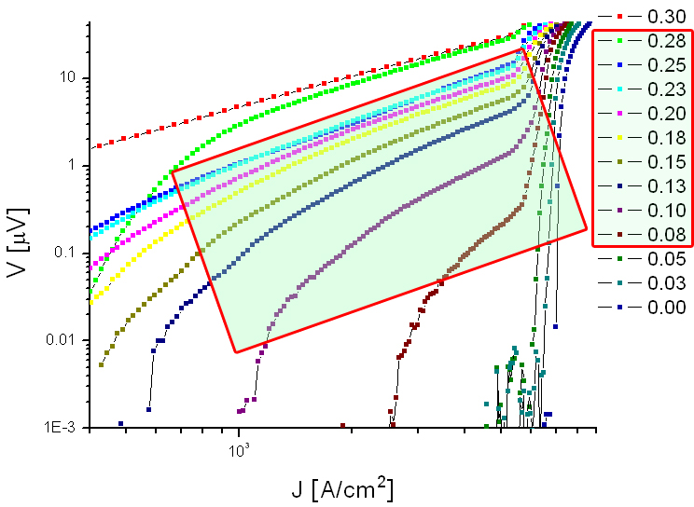
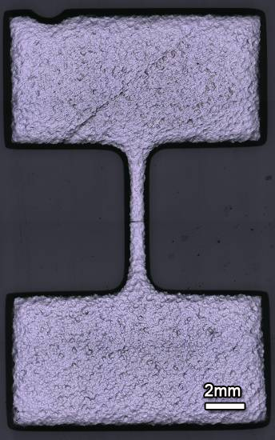
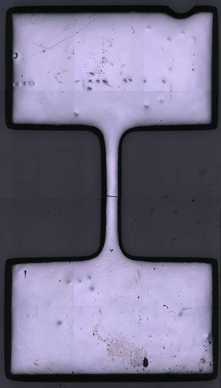
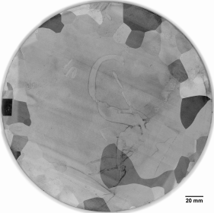
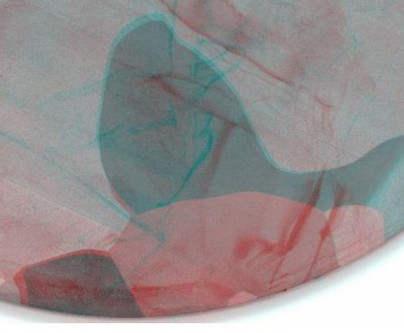
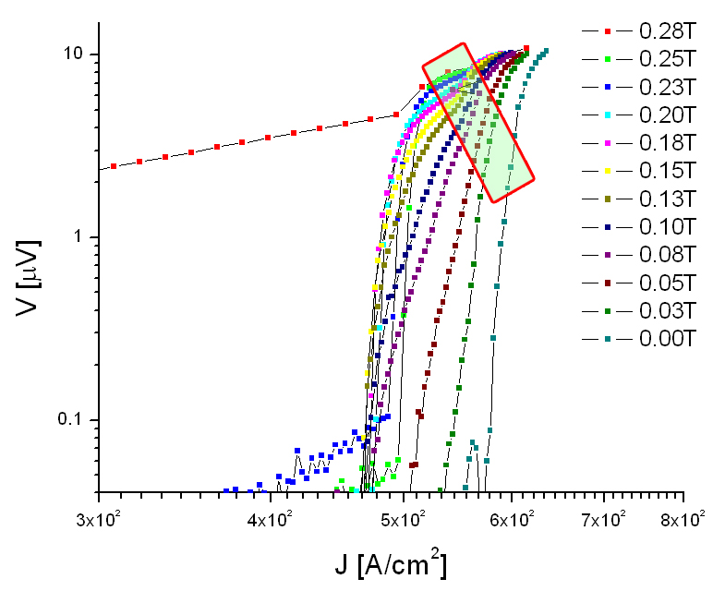
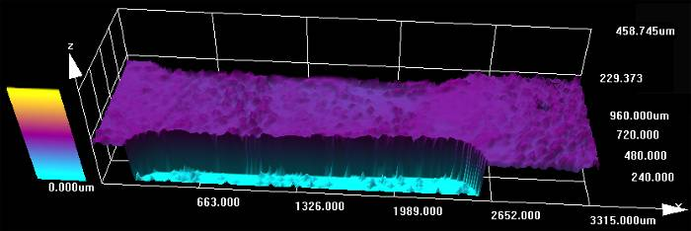
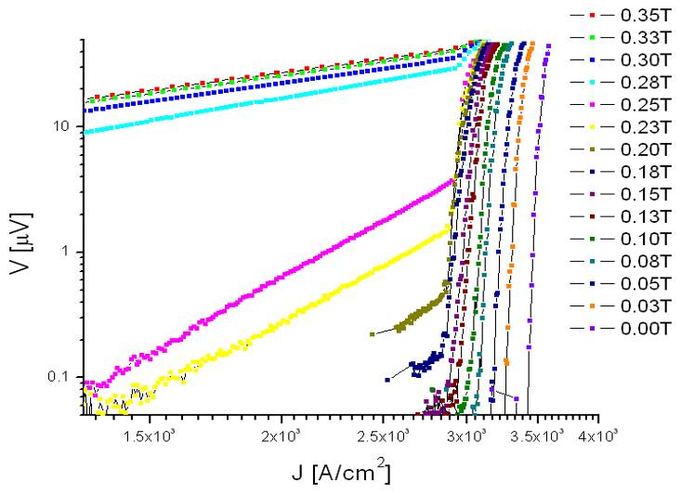
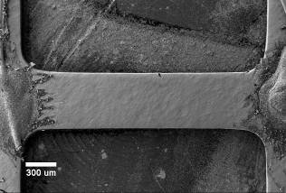
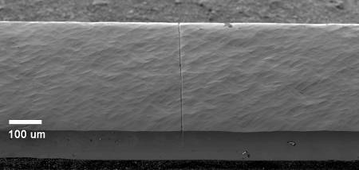
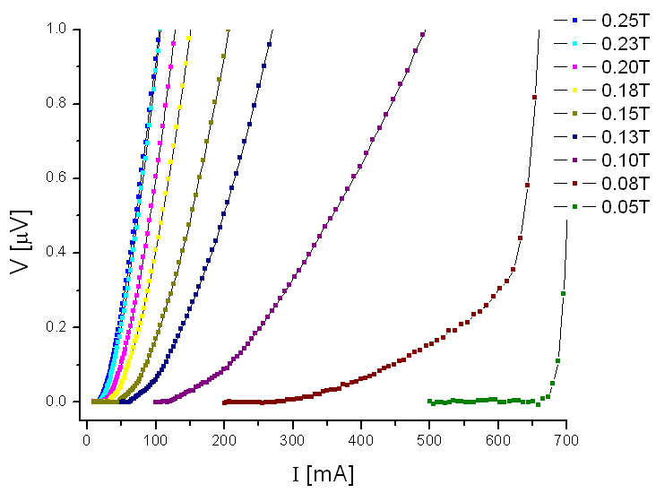
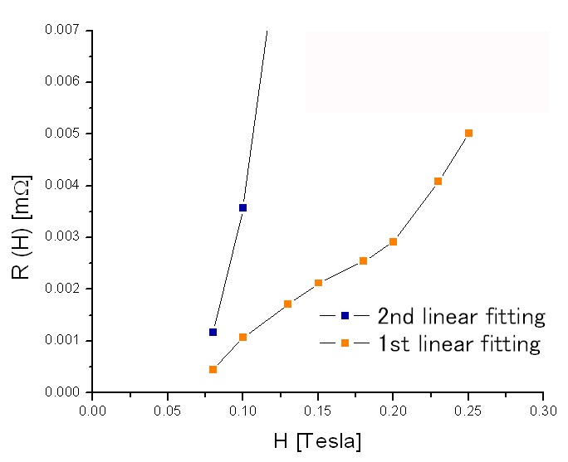
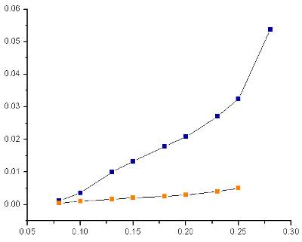
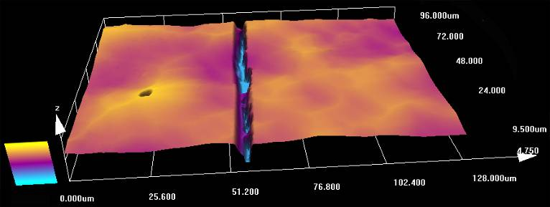
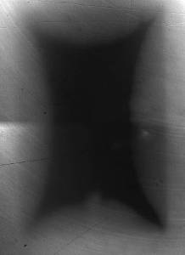
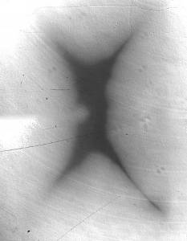
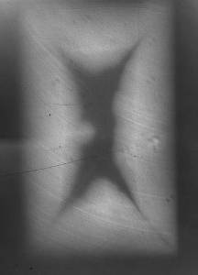
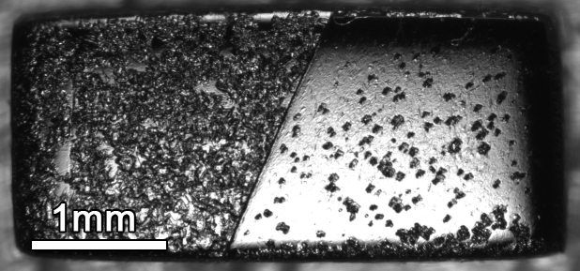
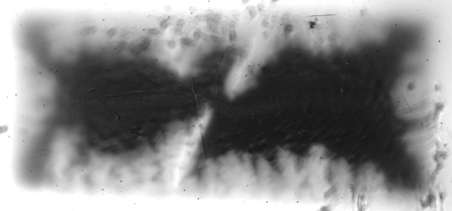
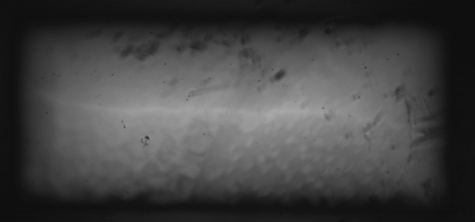
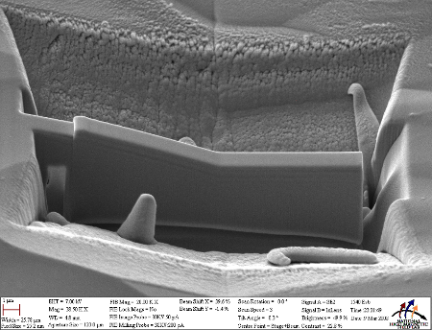
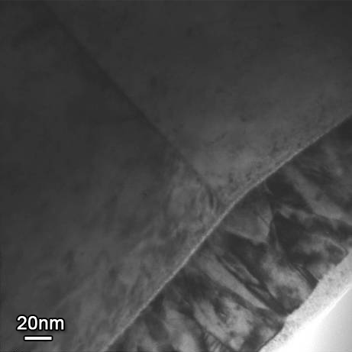
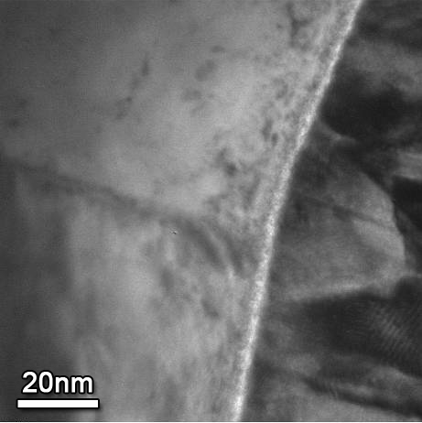
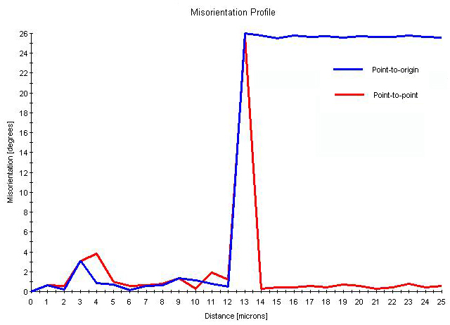
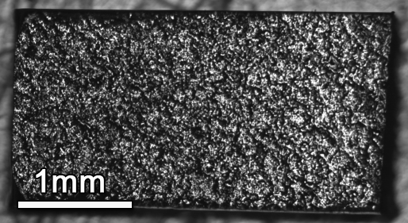
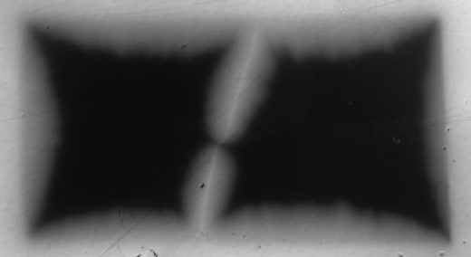
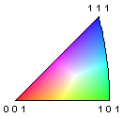
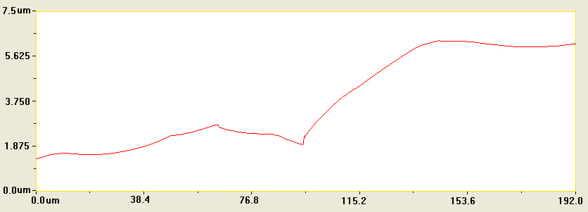
Suppressed superconductivity across BCP’ed Nb grain boundaries
Z.H. Sung, P.J. Lee, A.A. Polyanskii, A. Gurevich, D.C. and Larbalestier
Applied Superconductivity Center, National High Magnetic Field Laboratory at Florida State University, Tallahassee, FL, 32310, USA
Bi-crystals from high purity, large-grain, Nb
Current transport through the single grain boundary (GB)
Observation of flux penetration along GB with magneto-optical (MO) imaging
Measurements of surface topology with CLSM (Confocal Laser Scanning Microscope), Microstructure analysis with transmission electron microscopy and direct transport across the same GB in the superconducting state
Transport measurement
E-J characteristics of BCP'ed Nb
Transport current applied to chemically treated Single & Bi-crystal samples in a function of perpendicular magnetic field (at Temp 4.2K)
Single crystal
Bi crystal
Deep groove on the surface
Surface Conditions
1. BCP'ed Single & Bi crystals
2. EP'ed Bi crystals
3. Artificially grooved BCP'ed single crystal (by FIB - Carl Zeiss 1540 Esb)
4. Ultra finely flattened Bi crystal.
* All Bi-crystals were isolated from the same GB (Misorientation ~ 26°)
Description of samples
Large grain Nb sheet from JLAB
Surface image of I-shape sample after BCP treatment
One full slice, 3.1mm thick, cut from CBMM ingot was provided to our group by TJNAF for experimental analysis.
In this combined top and bottom image, Red arrow indicates “thinner” GBs have planes which are closer to the surface perpendicular. Blue arrow indicates “thicker-appearing” GBs are inclined ~25-30° from the perpendicular.
This as-received slice (RRR ~280, 3.1mm thick) has a very large grain size (~50-100mm), which allowed us to isolate multiple bi-crystals.
E-J characteristics of EP'ed Bi-crystal & Artificially FIB grooved Single-crystal
EP'ed Bi-Xtal
Uniform surface
E-J curve of BCP'ed Single crystal-like intra grain-indicates a typical smooth curvature of superconducting transition from negative to positive with increase H.
Yet, the curve of BCP'ed bi-crystal-like intra grain-shows pronounced grain boundary resistance due to flux flow along GB_{BCP} from H_{ext}≈0.08T
Surface topology
,
ρ_{n} = the normal state resistivity A = the cross-sectional area W (H, J) = the width of vortices channel, which exceeds the inter-vortex spacing a=(Ф₀/H)1/2 dVrow = the number of the vortex rows on the channel.
Fig. 1. Overview of the as-received niobium slice from CBMM Ingot
Courtesy of A. Gurevich
Sample preparation
Artificially grooved Single Xtal
SE2 image
Deep groove
 | 1st linear fitting |  |  | 2nd linear fitting
H [T] | W [μm] | dV | a [10⁻⁷] | W [μm] | dV
0.08 | 0.19 | 1.15 | 1.61 | 0.49 | 3.04
0.10 | 0.36 | 2.51 | 1.44 | 0.12 | 8.38
0.13 | 0.44 | 3.52 | 1.26 | 0.26 | 20.61
0.15 | 0.48 | 4.04 | 1.17 | 0.30 | 25.41
0.18 | 0.48 | 4.44 | 1.07 | 0.34 | 31.31
0.20 | 0.49 | 4.85 | 1.02 | 0.35 | 34.57
0.23 | 0.60 | 6.32 | 9.48 | 0.40 | 41.97
0.25 | 0.68 | 7.44 | 9.10 | 0.44 | 48.17
Linear scale of BCP'ed Bi Xtal
Flux flow resistivity R_{F}(H)
Isolated different single & bi-xtal samples with wire-EDM as indicated in Fig. 1.
Red rectangle for MO imaging and atomic-scale structure analysis
Blue rectangle for transport measurement
I-shaping (Dog-bone) → mechanical polishing → typical cavity inner surface treatments
Surface treatment after EDM cutting
BCP (Buffer Chemical Polishing) treatment
HF (48%) : HNO₃(69.5%) : H₃PO₄ (85%) = 1:1:2 ratio
Aggressively etch away the grain boundary so that a big groove is created at the grain boundary
EP (Electropolishing) treatment
HF (48%) : H₂SO₄(96%) = 1:9 ratio
Voltage = 10-15V & Current density = 30 to 100 mA/cm²
Relatively uniformly remove surface layers
BCP’ed
Surface topology
Suppression of superconducting properties not as clear for EP’ed GB.
For an artificial groove, simulating BCP’ed GB topology on theBCP’ed Single crystal, we do not observe the same change in the VI-curve that is associated with flux-flow resistivity in the grain boundary.
Summary
Nb GBs show evidence for preferentially flux penetration (external dc magnetic field parallel to the GB plane) using Magneto Optical imaging.
Measured E-J characteristics for BCP'ed and mechanically flattened Nb Bi-crystals show a clear evidence for grain boundary weakness due to preferential flux flow along the GB.
Our data indicate that pinning of vortices along GBs is weaker than pinning of vortices in the grains, which may indicate suppressed superfluid density on GBs, which thus can contribute to enhanced rf losses in hotspots on the surface of Nb cavities.
However, flux flow resistivity RF(H) extracted from our data deviates from the model developed by Alex Gurevich for the flow of AJ vortices along the grain boundary on HTS. This may be due to shape effects and further experiments are underway to make direct measurements of the local magnetic flux density.
MO imaging on tilted GB
Reduced thickness sample (GB//H_{ext})
Microstructure Analysis
Non-uniform flux penetration into bi-xtal (100min BCP).
BCP'ed
ZFC T=6K
FC T=6K
TEM was used to observe the vicinity of the GB after BCP treatment
Top & Bottom
ZFC
T=6K
Remnant state
GB
Using FIB (Carl Zeiss 1540 Esb), we prepared TEM lamellae from the GB of the same sample after MO imaging
Double cap layers (Au-Pd & C) protected the surface Nb-O layers from radiation damage of FIB source
~23.6° tilted GB
H = 58 mT
H = 0 mT
5mm (W) × 6.1mm (H) × 3.1mm (T)
H = 60mT
H = 120mT
T=6K H = 0mT
Same GB & thickness sample (GB//H_{ext})
No oxide indentation at the GB
Thickness of Nb oxide; ~ 5-7nm
EP'ed
ZFC T=6.5K
FC T=6.5K
GB
GB
Height profile at GB
Oxide
Oxide
Au-Pd
Au-Pd
Misorientation ~ 25.7 °
H = 72 mT
H = 0 mT
C
ACKNOWLEDGMENTS
High-purity, large-grain niobium sheet was provided by TJNAF.
This work was supported by the US DOE under grants DE-FG02-06ER41450,
DE-FG02-07ER41451 FNAL PO 570362 and the state of Florida.
1
4
t
h
I
n
t
e
r
n
a
t
i
o
n
a
l
C
o
n
f
e
r
e
n
c
e
o
n
R
F
S
u
p
e
r
c
o
n
d
u
c
t
i
v
i
t
y
S
e
p
t
e
m
b
e
r
2
0
-
2
5
,
2
0
0
9

