Slide 1
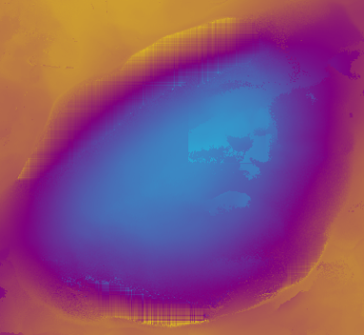


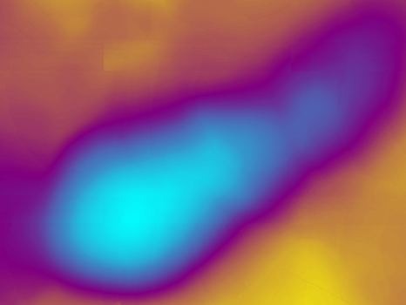
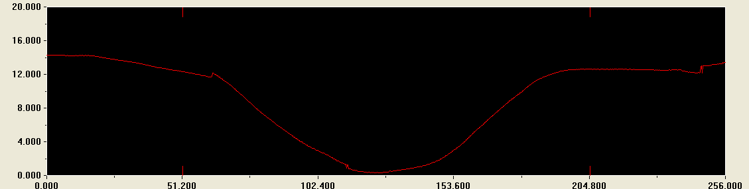
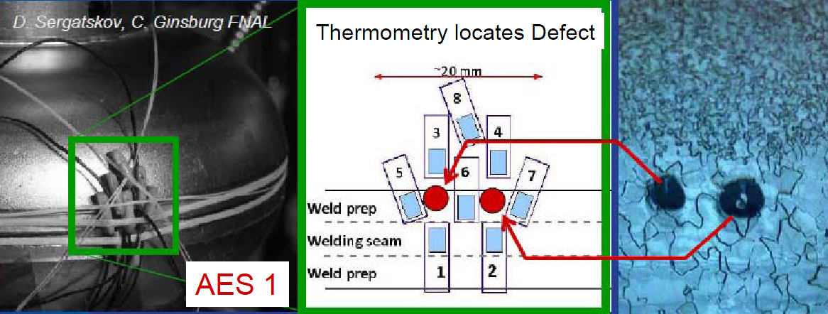
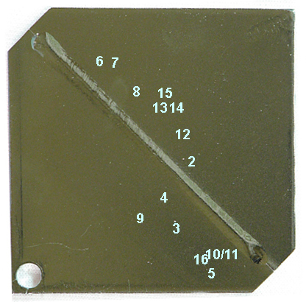
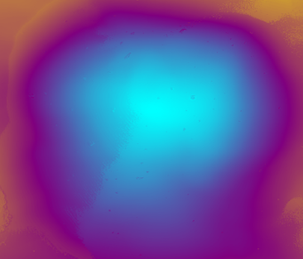
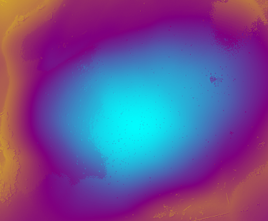
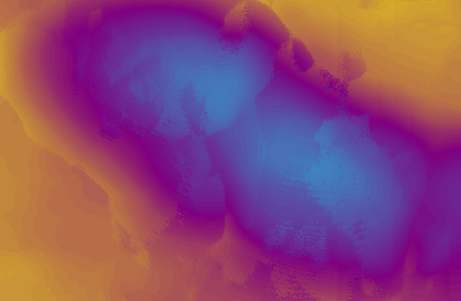
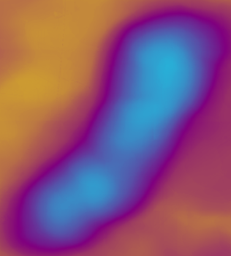
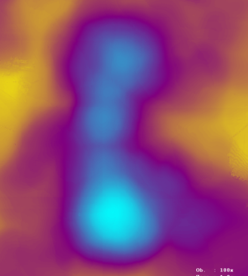
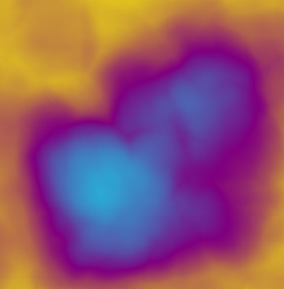
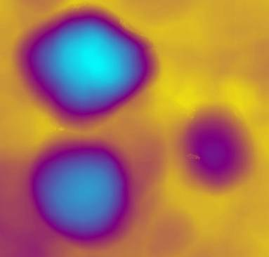
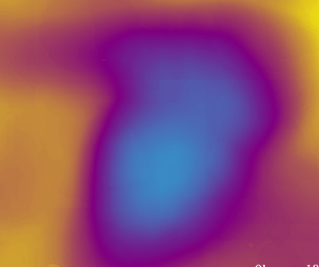
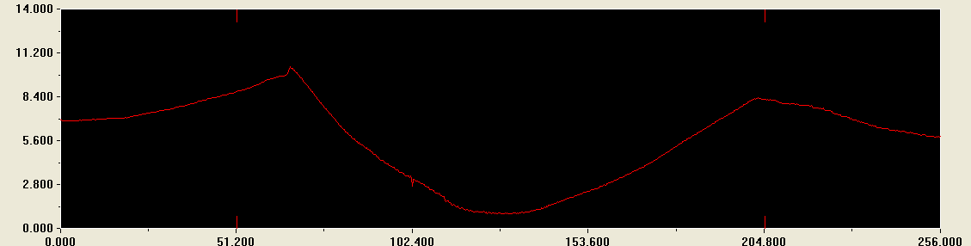
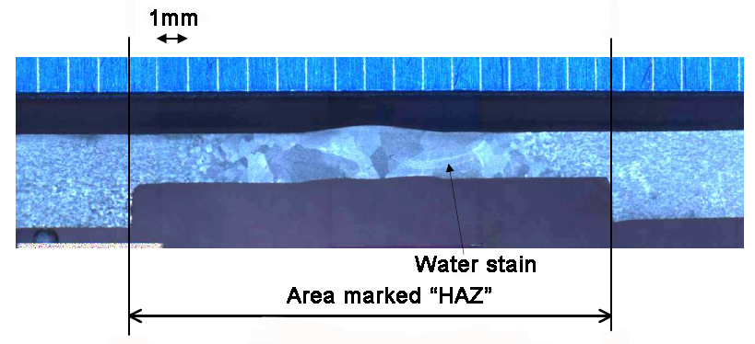
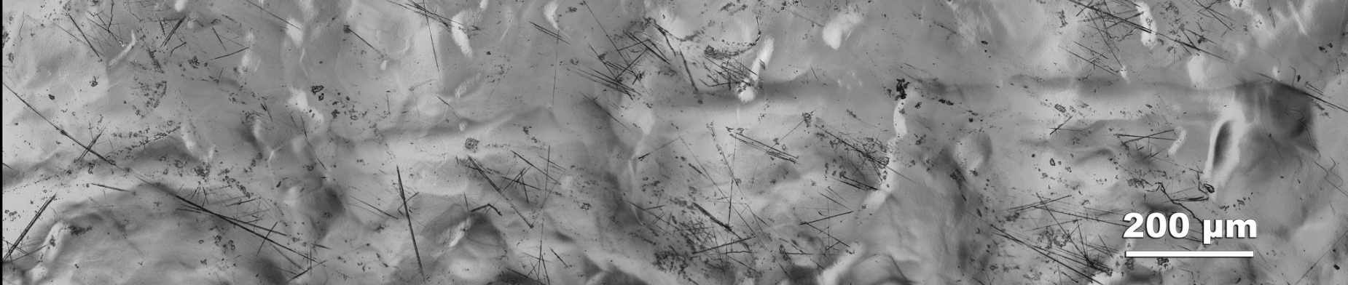
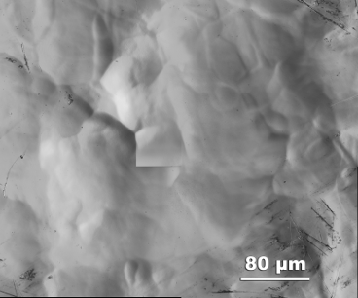
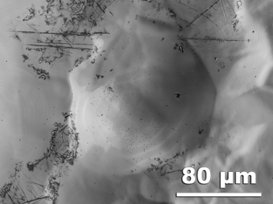
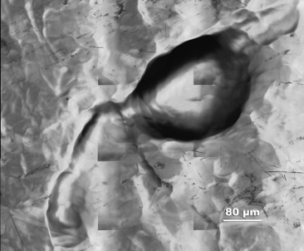
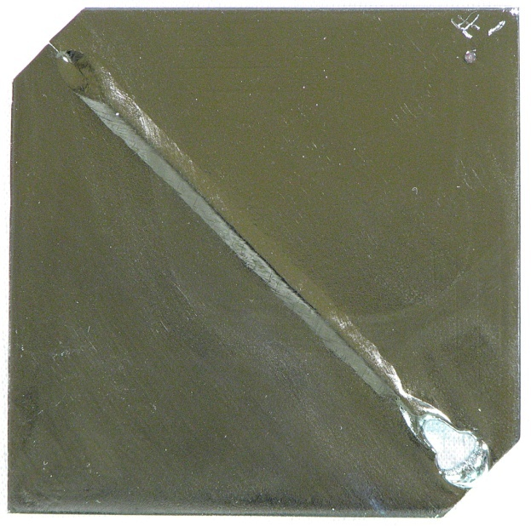
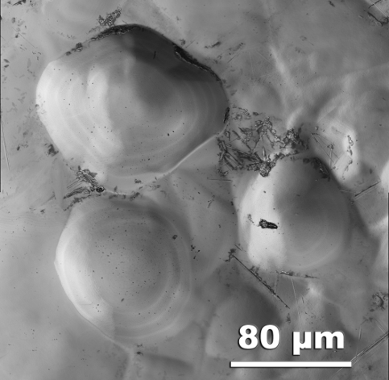
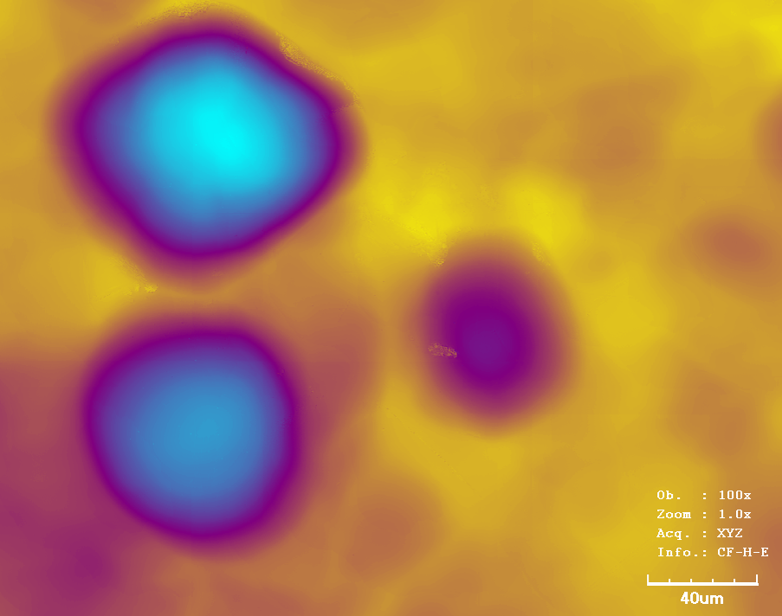
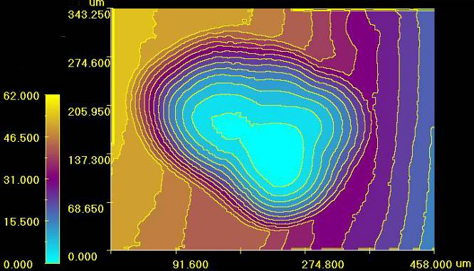
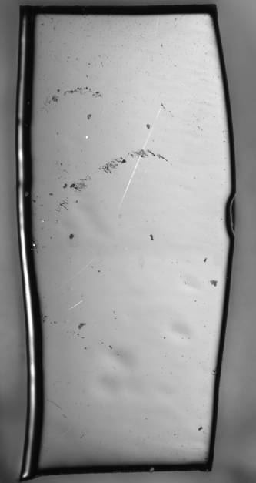
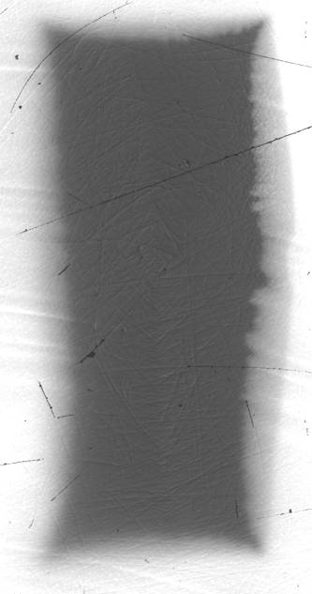
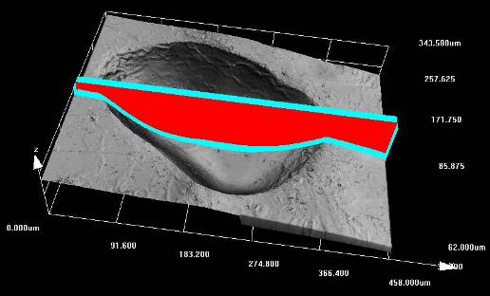
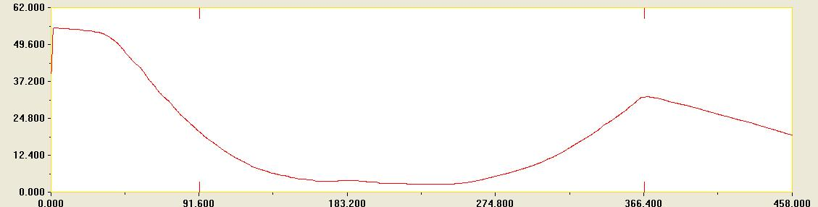
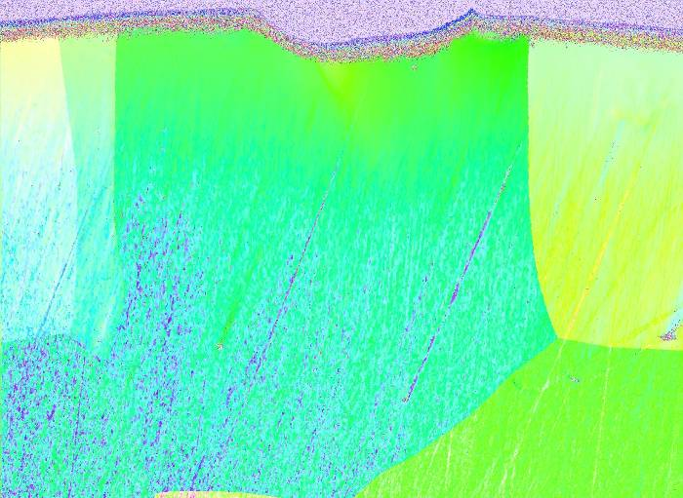
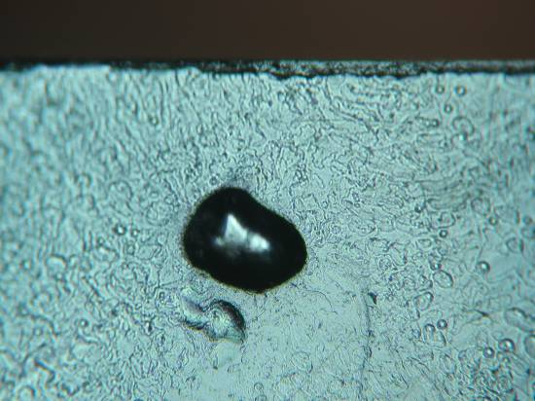
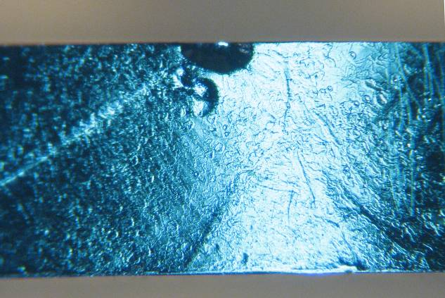
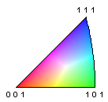
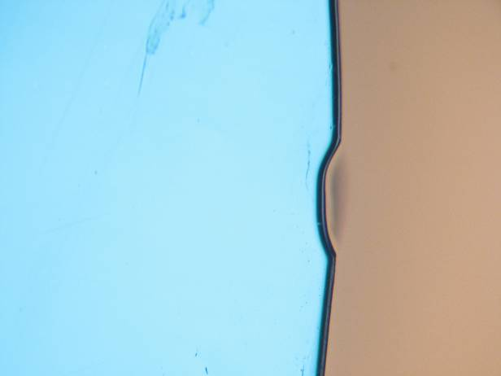


Surface Morphology of Welding Pits on HAZ of Electropolished Nb
Z.H. Sung¹, S. Boland¹, A.A. Polyanskii¹, P.J. Lee¹, D.C. Larbalestier¹, L.D. Cooley² and M. Ge²
¹ Applied Superconductivity Center, National High Magnetic Field Laboratory at Florida State University, Tallahassee, FL, 32310, USA
² Fermi National Accelerator Laboratory, Batavia, Illinois, 60510, USA
INTRODUCTION
A strong correlation has been observed between hot spots found by temperature mapping and large pits near the edge of the heat-affected zone (HAZ) of cavity welds seen by optical inspection in those cavities with performance below 30 MV/m (part of the “yield step” at 20 MV/m).
DETAILED CLSM PROFILES
LOCATION AND DIMENSIONS OF PITS
Dish-Shaped Pit Profile
Pit | Depth (µm) | Length (µm) | Width (µm) | Distance from weld line (mm)
2 | 23.1 | 225.2 | 149.7 | 2.340
3 | 9.3 | 115.6 | 100.1 | 6.235
4 | 11.4 | 129.5 | 117 | 10.272
5 | 6.2 | 180.7 | 87.7 | 10.687
6 | 12 | 123.8 | 106.9 | 3.047
7 | 9.4 | 108 | 87.1 | 3.220
8 | 11.3 | 180.5 | 71.5 | 3.947
9 | 9.8 | 258 | 72.1 | 14.585
10 | 5.6 | 98.5 | 93.2 | 5.567
11 | 5.7 | 107.7 | 77.6 | 5.567
12 | 12.2 | 248 | 206.8 | 3.575
13 | 13.2 | 92.1 | 82.2 | 5.875
14 | 5.6 | 41.8 | 34.9 | 5.875
15 | 8.4 | 78.4 | 76.9 | 5.875
16 | 6.9 | 155.1 | 81.7 | 11.745
The Profile display of Pit 6 taken with a 50x objective lens on the CLSM
Optical Inspection by Hayano group – Kyoto.
See Burk et al. PAC’09
EP-Nb 1a 6-2 8-25-08
Pit 2
Pit 3
Pit 4
Pit 5
2 cm
Sharp Raised Rim of Pit Profile
This study used high resolution confocal laser scanning microscopy (CLSM), to measure pit topology in the HAZ of electropolished Nb coupons prepared at FNAL.
We also performed a preliminary investigation into the effect of pits on local superconducting properties using Magneto Optical imaging.
Pit 6
Pit 7
Pit 8
Pit 9
The Profile display of Pit 7 taken with a 50x objective lens on the CSLM
All pits were found within 15 mm of the edge of the weld seam.
SAMPLES
Pit 10/11
Pit 12
Pit 13/14/15
Pit 16
Before EP
PIT MORPHOLOGY
Most pits found on the coupon have a “round” or hemispherical shape as shown.
Comet-like tails are also common
The extremely long comet tail (~2 mm) runs parallel to the weld seam (pit #16).
Two pieces of corners of Nb sheet used in 9AES001
Corner pieces were machined to the same contour as the equator joint and given the same weld prep before welding:
Welds were made by Mike Foley (Sciaky) with parameters as close as possible to actual parameters used on 9AES001 (3 passes: tack, seal, full penetration)
Equator Sample Weld Parameters
All four weld samples were prepared with two tack welds (one tack weld at each end of
the joint), followed by a seal weld pass to get heat into the pieces to be joined. The tack and seal weld parameters for all four samples were:
Tack Weld: 50 kV, 20 mA, 30 ipm material feed rate.
Seal Weld: 50 kV, 25 mA (1.0 sec dwell) followed by 25 mA for weld, 18 ipm material feed rate. E-beam oscillating on 0.040” diameter circular path at 100 Hz puddle frequency (PF).
Final Weld: 50 kV, ~43 mA, 18 ipm
pit
The pit #13-15 cluster is very suggestive of a bubble raft with flat interfaces between the bubbles.
Most pits have a simple dish-like shape. There seem to be no central features.
MAGNETO-OPTICAL IMAGING ON pit CROSS-SECTION
Surface
ZFC T=6.5 K
FC T=6.9 K
2 cm
HAZ
EP-Nb 1a 6-2 8-25-08
EP in a lab beaker with similar parameters used for FNAL 9AES001 cavity but with some differences:
Nb and Al parallel plates in a
beaker, stir bar at the bottom.
Teflon mesh between.
• Niobium wire used to suspend sample – wire etched through several times
• Weld side faced Al cathode;
both sides were exposed
• Temperature not under control; process stopped to cool bath several times
• Current oscillations at fixed
voltage once plateau reached.
• 210 µm total removal in 6 hrs
(0.6 µm/min)
• 14.5 V, not well controlled at
first
• 2.3 to 3.2 A (60-80 A/cm²)
• Temp rose 18 to 32 °C
PIT CROSS-SECTIONING
0.5 mm
H = 60 mT
H = 0 mT
We extracted the weld that includes pit #1 with a precision diamond saw and then mechanically polished to the half depth
The direction of mechanical polishing
No change in local DC SC behavior observed by MO
The edge of the diamond cut
SUMMARY
EP’ed surface
Using high resolution CSLM, we observed topological features of welding pits on EP'ed Nb coupon and categorized the pits into three groups based on their characteristics contours.
Transverse cross sectioning showed profile similar to that measured by LSCM
The “tails” on the “comet” morphology suggests that these pits originated from bubbles of some sort that traveled along the surface of the coupon.
~25% of the pits had raised rims around their top surface
We did not observe a change of flux penetration on the pit under DC field.
Polished surface
1 grain
Before mechanical polishing
SEM image
OIM image
0.5 mm
Cross-sectional polishing allowed measurement of the crystallographic orientation under the pit and direct observation of the pit profile in the SEM
After mechanical polishing
Polished surface
1
4
t
h
I
n
t
e
r
n
a
t
i
o
n
a
l
C
o
n
f
e
r
e
n
c
e
o
n
R
F
S
u
p
e
r
c
o
n
d
u
c
t
i
v
i
t
y
S
e
p
t
e
m
b
e
r
2
0
-
2
5
,
2
0
0
9
TUPPO075
ACKNOWLEDGMENTS
FNAL EP: Charlie Cooper, Donna Hicks, Dave Burk, Rob Schuessler, Chad Thompson
Funding by FNAL PO 570362 and the State of Florida.
C
o
n
f
e
r
e
n
c
e
P
r
o
g
r
a
m
m
e
a
n
d
A
b
s
t
r
a
c
t
s

